Slide 1
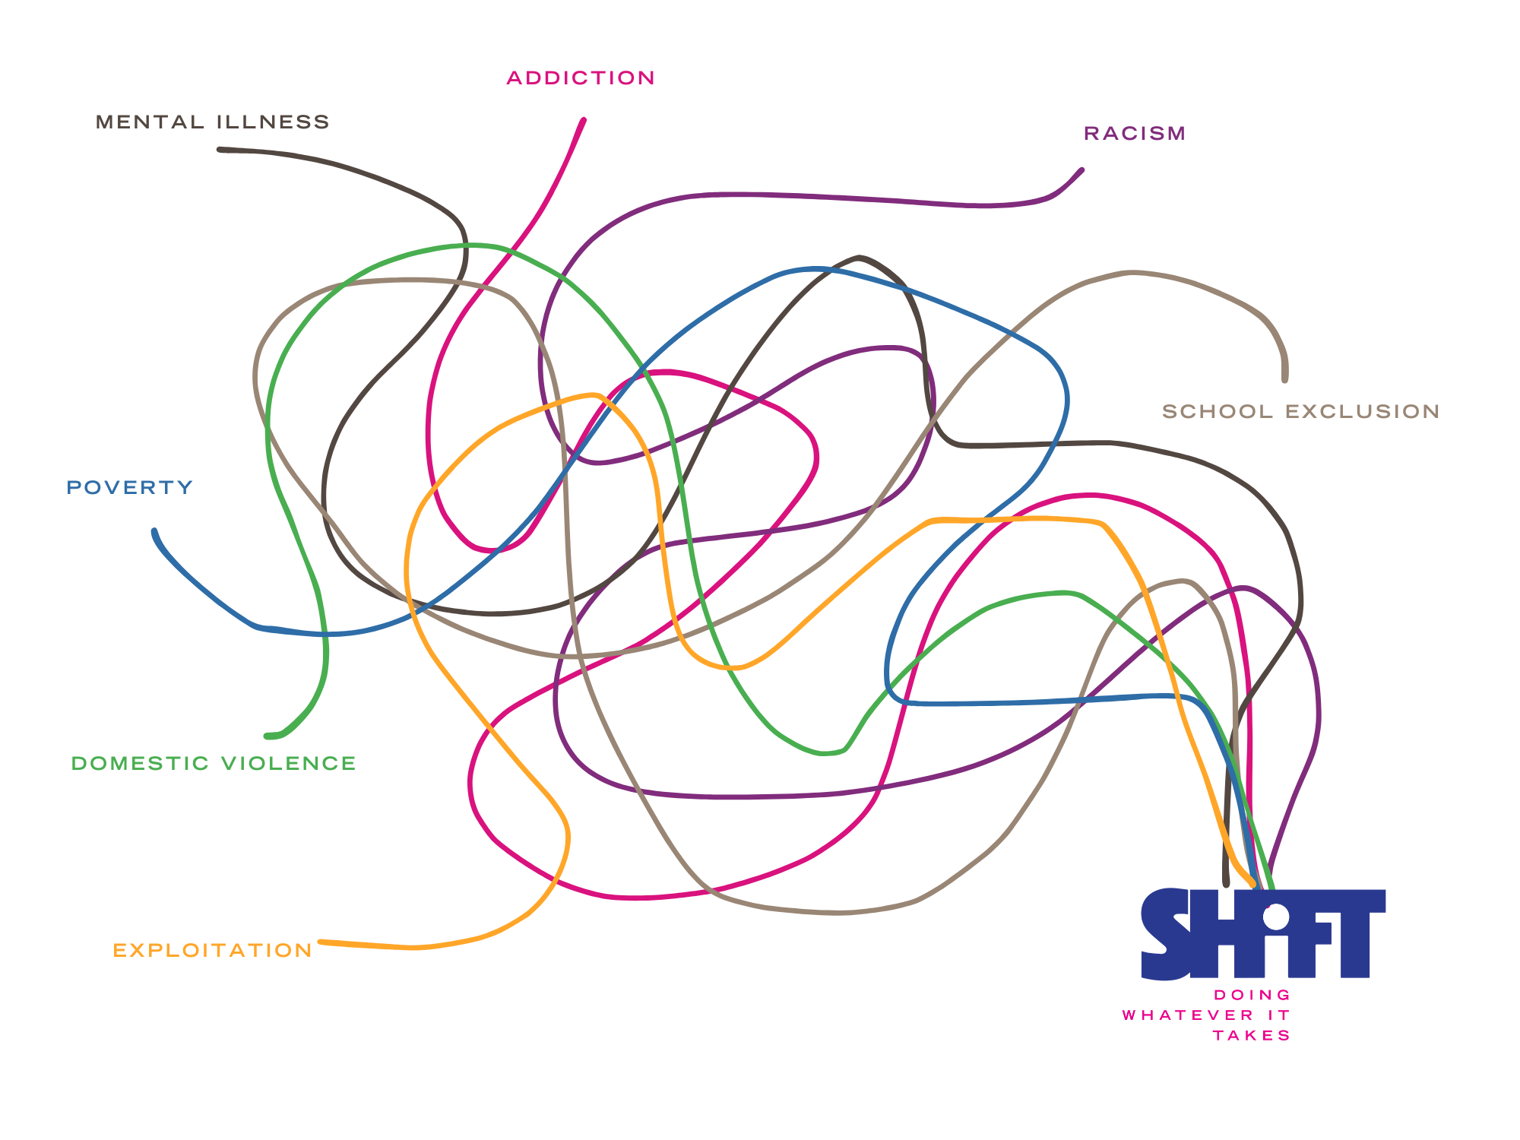
BREAKING CYCLES FOR CHILDREN CAUGHT IN COMPLEX CIRCUMSTANCES ACROSS YOUTH AND FAMILY JUSTICE

Slide 2

GROWING UP IS RISKY BUSINESS
Too many children are growing up without the support and challenge they need to move to a place of safety and strength.
For too long, responses to children caught up in, or at risk of, crime have been short-term, fragmented and reactive - often shaped by thresholds, handoffs and silos rather than enduring relationships.
The consequences are devastating for children, families and communities.
Children who are Black, Brown, Mixed Heritage, and from Gypsy, Roma and Traveller communities are disproportionately affected.
SHiFT is determined to change this.

Slide 3
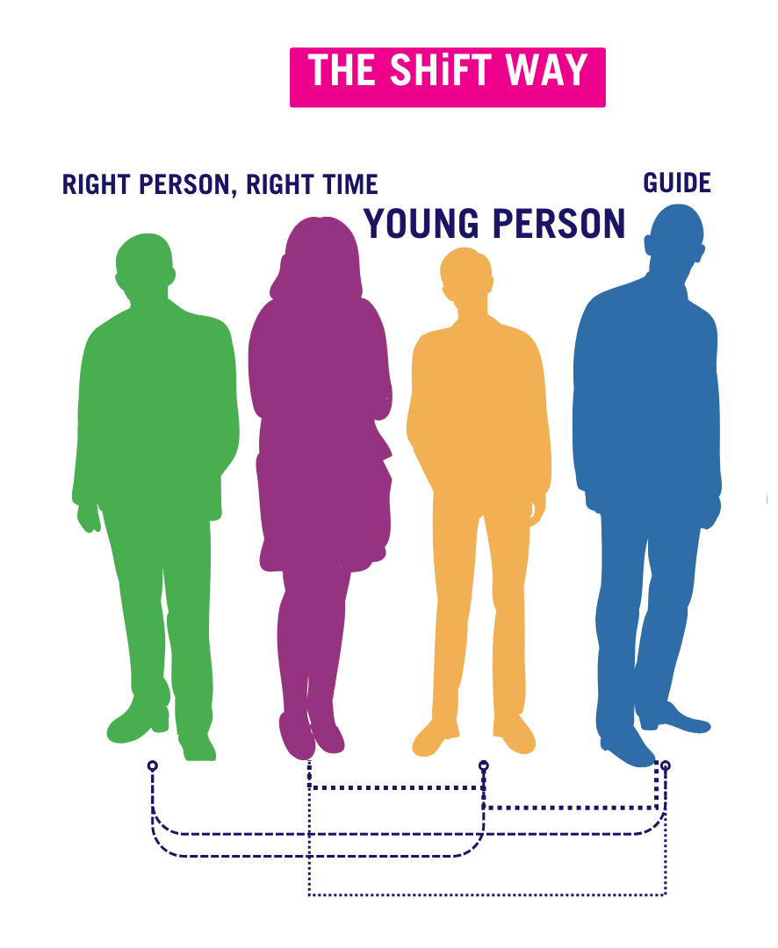
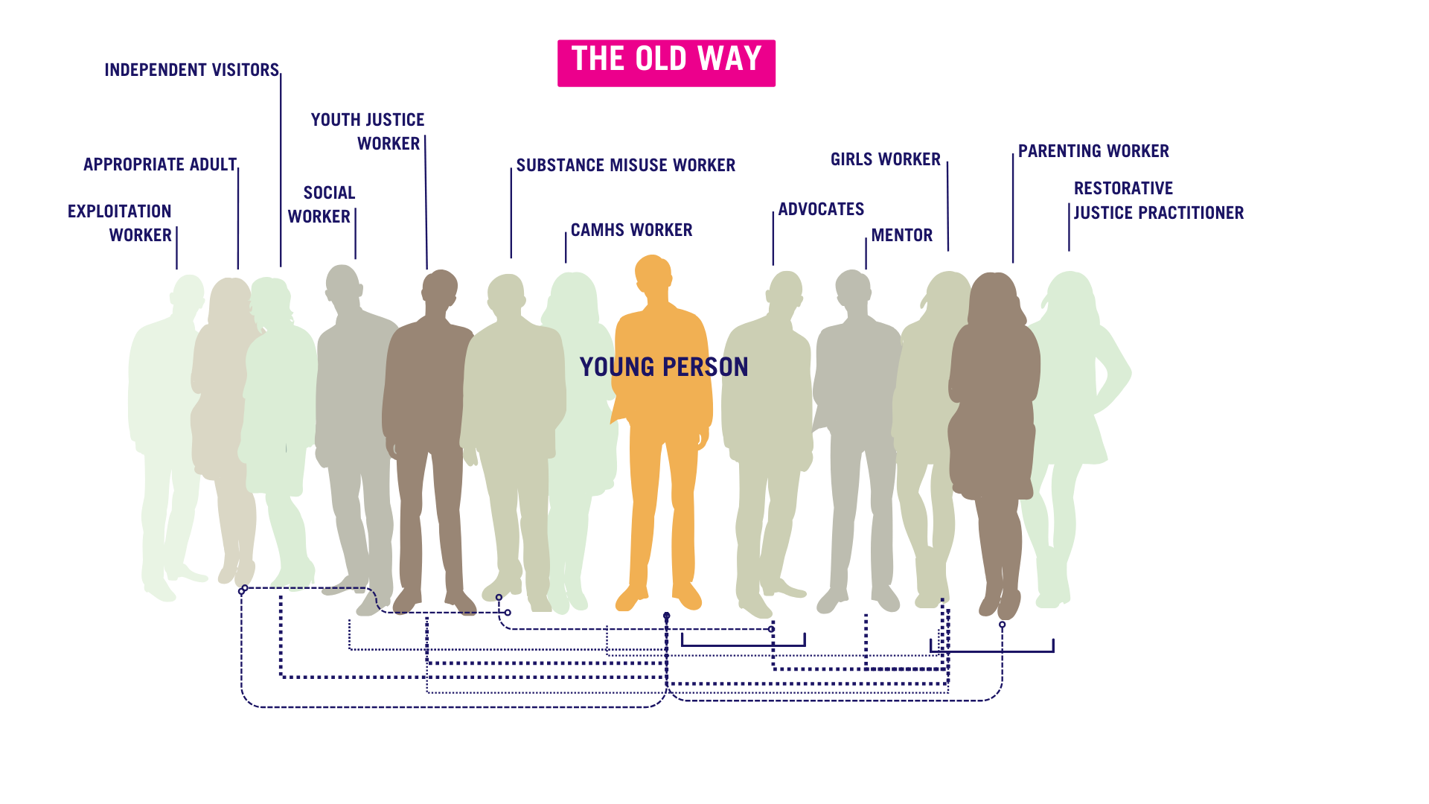
SHiFT’S VISION
SHiFT wants every child caught up in, or at risk of, crime to have one intensive and persistent professional relationship through which most of their needs are met: a flexible, tailored, and enduring relationship through which we do whatever it takes to set children up for safe and bright futures.
We want services designed to prioritise the development of such relationships and their maintenance across life changes that are currently man-made trenches, such as when a child turns 18, moves school or area, goes into or out of custody, or crosses a ‘threshold’ for the involvement of statutory services.

Slide 4
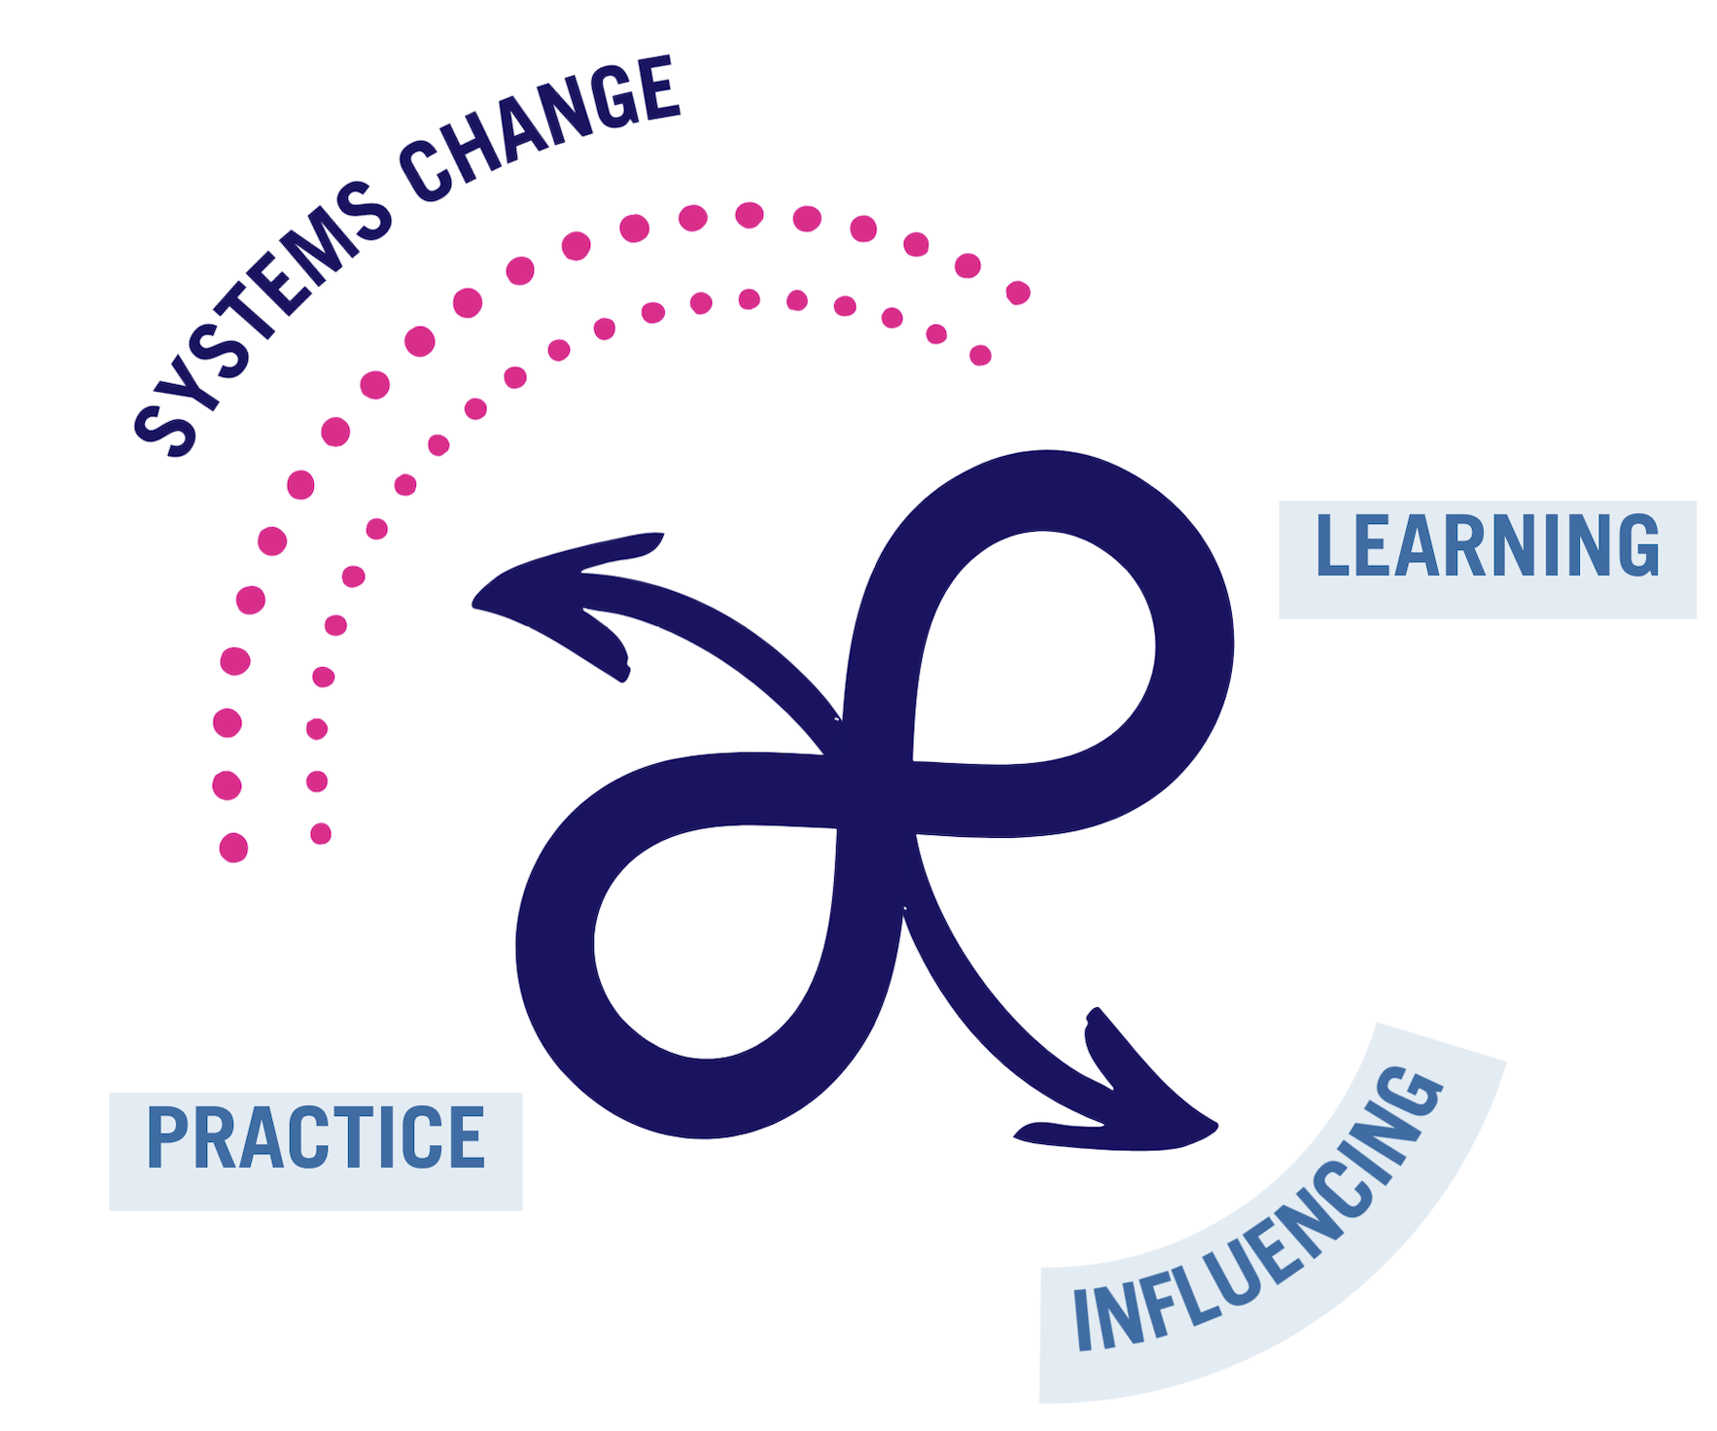
SHiFT’S MISSION
SHiFT exists to break the destructive cycle of children and young people caught up in, or at risk of, crime.
We seek to transform policy and practice in how young people in these circumstances are seen and supported.
We do this by combining intensive systemic practice, learning, and systems change.

Slide 5
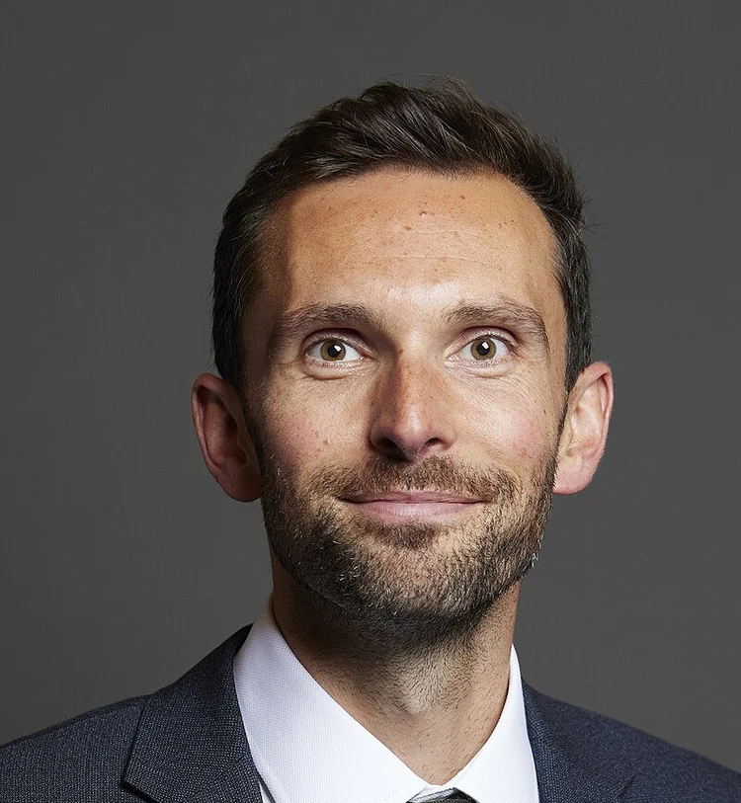
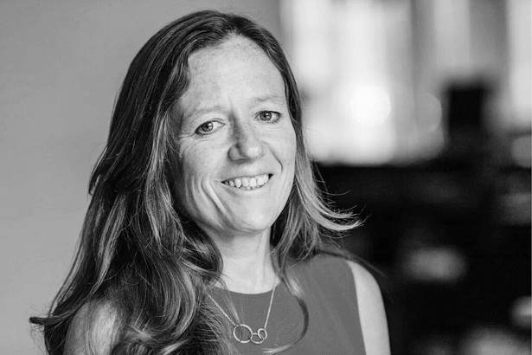
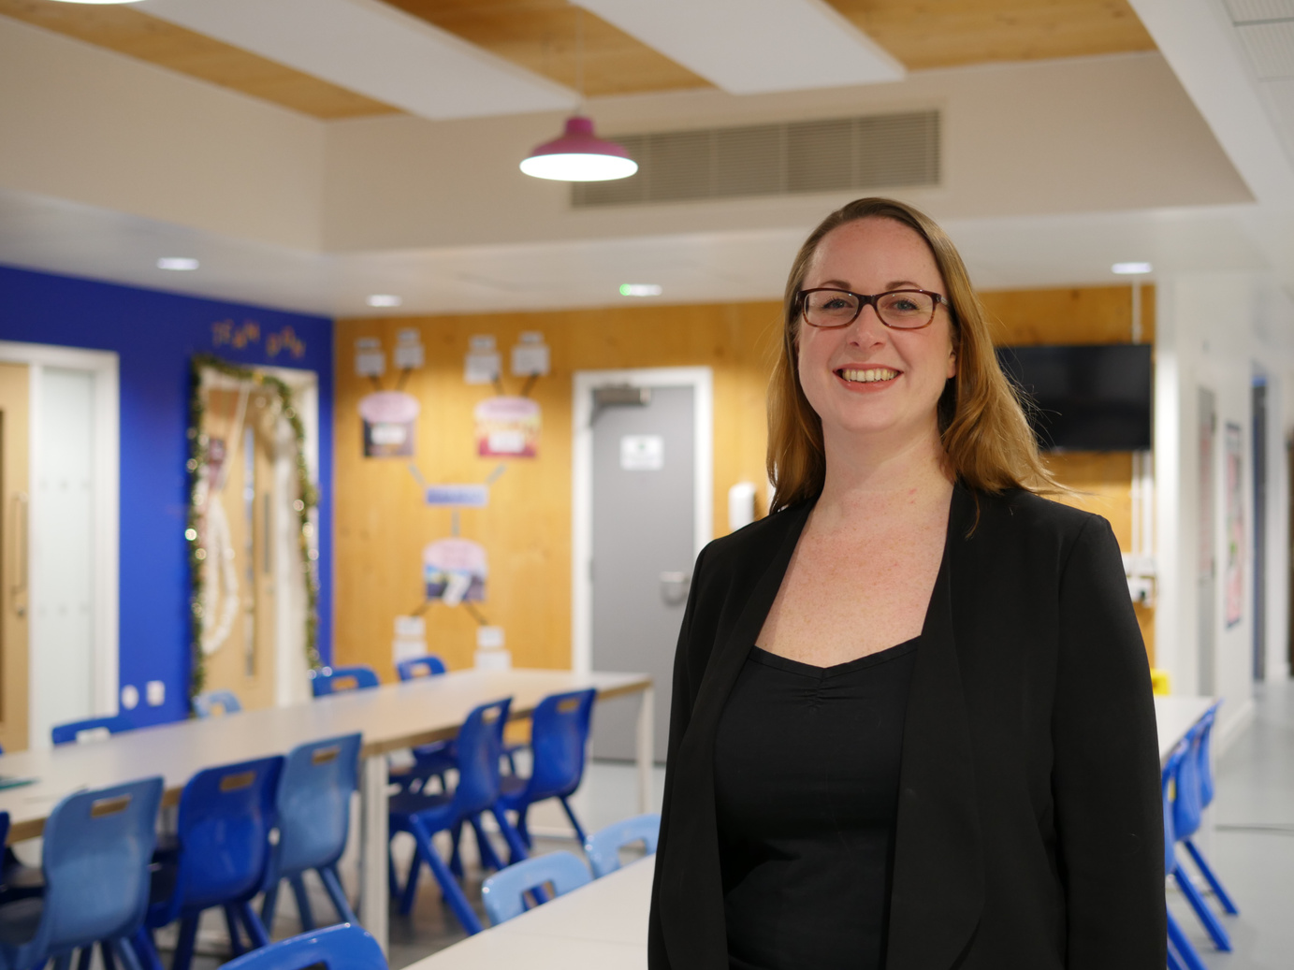
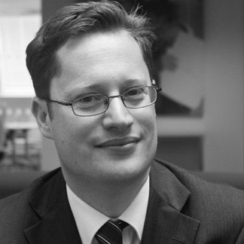

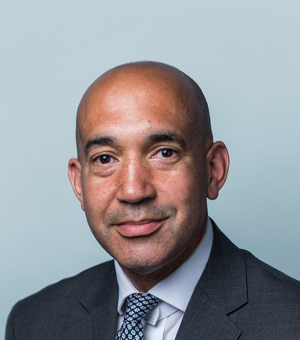
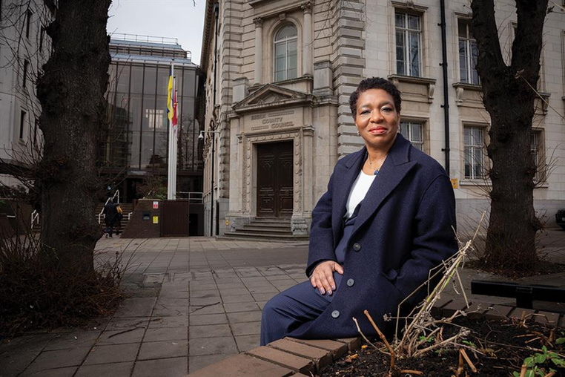
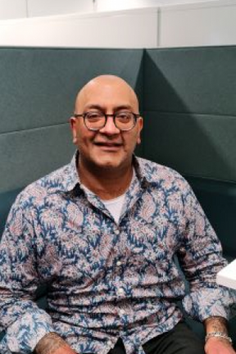
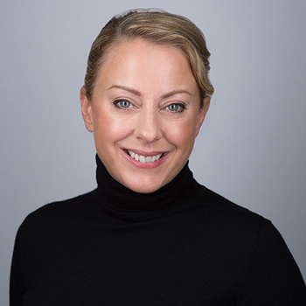
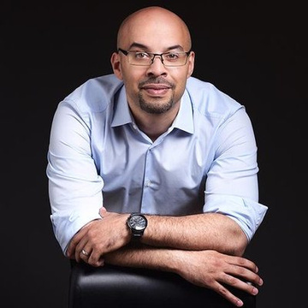
OUR PEOPLE
JOSH MACALISTER OBE MP
CO-FOUNDER
SOPHIE HUMPHREYS OBE
CO-FOUNDER AND TRUSTEE
REBECCA CRAMER
CO-FOUNDER AND TRUSTEE
MICHAEL CLARK
CO-FOUNDER
PROFESSOR MARTIN GRIFFITHS CBE
CHAIR OF BOARD OF TRUSTEES
KEIR MONTEITH KC
TRUSTEE
PAM PARKES
TRUSTEE
RASHEED PENDRY OBE
TRUSTEE AND PRACTICE
COMMITTEE CHAIR
SARAH HAZZLEDINE
TRUSTEE
DR LUKE ROBERTS
TRUSTEE AND RESEARCH & EVALUATION COMMITTEE CHAIR

Slide 6
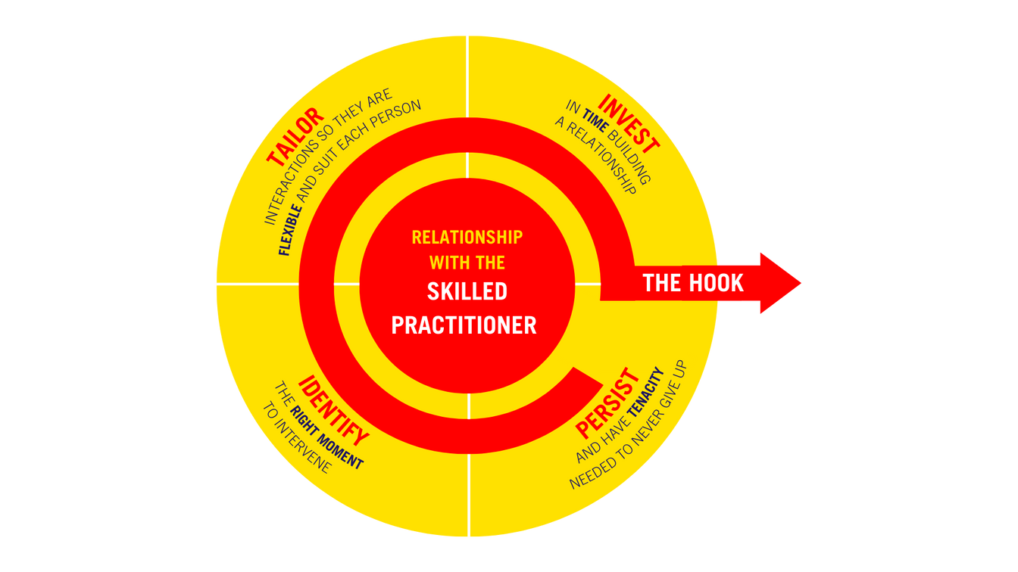
BREAKING CYCLES
SHiFT’S CORE INGREDIENTS
At the heart of everything we are, and everything we do is Breaking Cycles – a dynamic and evidenced approach to enabling change, created and pioneered by SHiFT’s Co-Founder, Sophie Humphreys OBE.
THE HOOK IS WHATEVER MOTIVATES A PERSON TO THINK, REFLECT, AND BEGIN TAKING STEPS TOWARDS A BETTER LIFE
The ingredients of Breaking Cycles have been tested and evaluated as successful at Pause, the organisation founded by Sophie Humphreys in 2013. Pause works to prevent the damaging consequences of children being taken into care.
Sophie Humphreys OBE

Slide 7
FROM | TO
doing what existing processes make easiest | doing what is right by the child
focusing narrowly on immediate safety | going for gold across all aspects of life
short-term intervention and handoff | holding and pulling for help through one consistent relationship
seeing individual problems to be fixed | seeing relational patterns that can be influenced
working in fragmented hierarchies | staying in the complexity as integrated networks of support

Slide 8
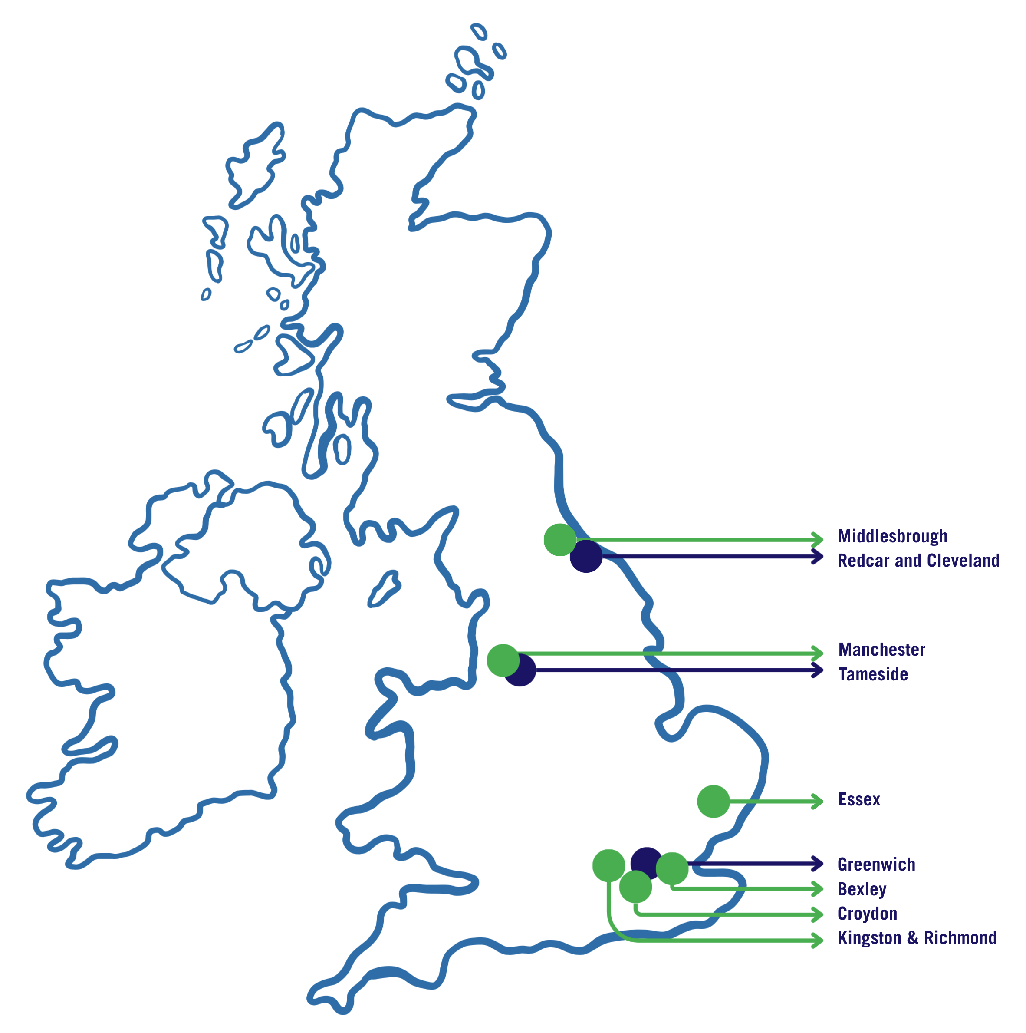
SHiFT IN ACTION
SHiFT Practices are tailored to meet local needs and priorities. This means that each SHiFT Practice has a slightly different character, though we all work to the same vision, and values and within a common Framework.
To date we have launched nine practices, with seven currently in operation.
Kingston and Richmond (January 2021), Greenwich (July 2021), Bexley (July 2022), Tameside (December 2022), Manchester (November 2023), Middlesbrough and Redcar & Cleveland (May 2024), Essex (July 2025), Croydon (May 2026).

Slide 9
SYSTEMS CHANGE ACROSS FAMILY AND YOUTH JUSTICE
Parallel proceedings - DoLs, care, crime. Crown Court backlogs.
‘Child First’ policing, prosecution… child remand population, 18-25 prison population.
Meaningful harm reduction outside of the criminal justice system?
A child protection system to meet teenage needs – risk inside and outside the home (contextual safeguarding), ‘violence fixated individuals’, agency and autonomy, residential and DoLs crisis.
CAMHS thresholds, waiting lists.

Slide 10


