Slide 1
Injuries in children under 1 year old
Dr Basheer Peer Mohamed
Consultant Paediatrician

Slide 2
Aims
An overview of accidental and non-accidental injuries in infants
Q &A

Slide 3
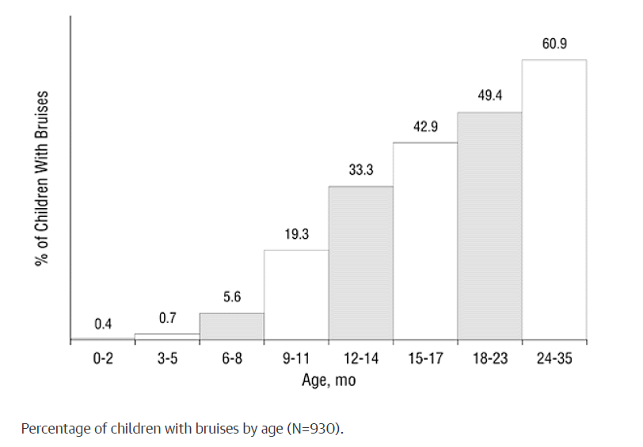
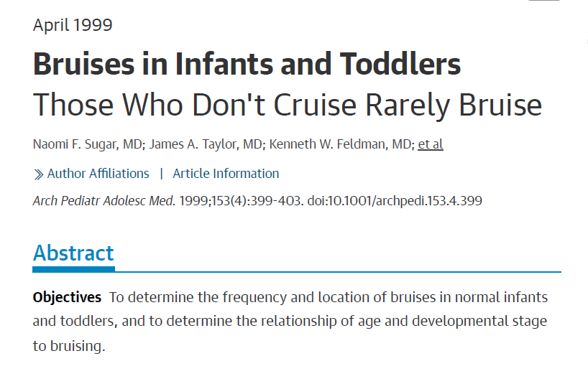
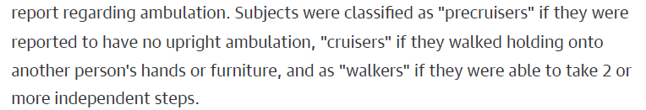
Accidental injuries- Bruising
Rare
Those who cruise don’t bruise

Slide 4
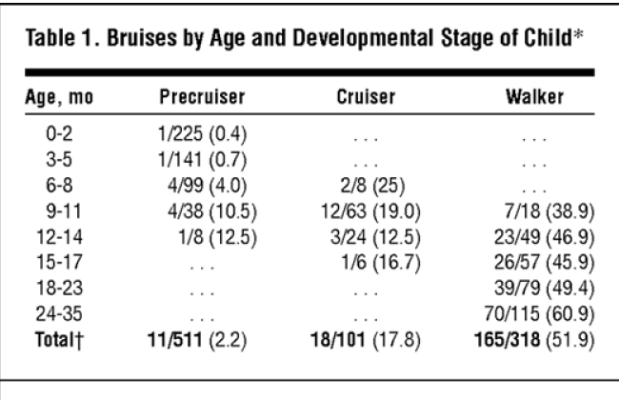
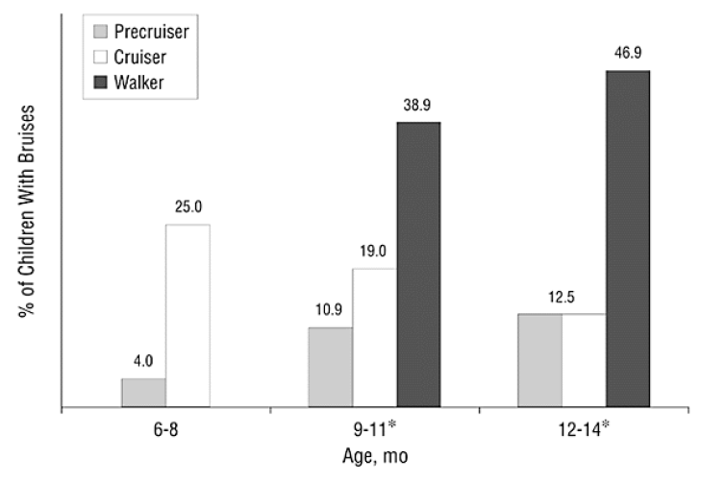
Those who cruise don’t bruise

Slide 5
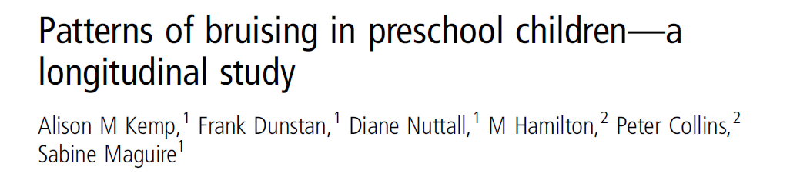
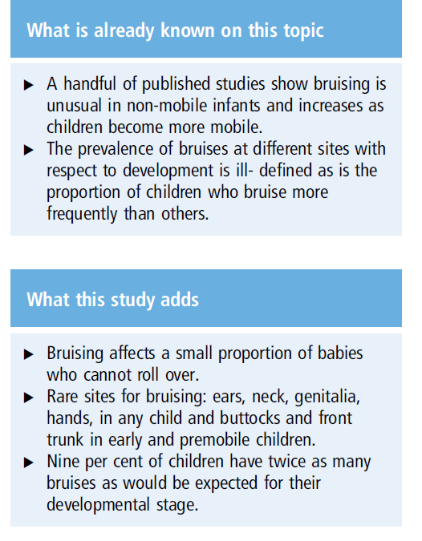
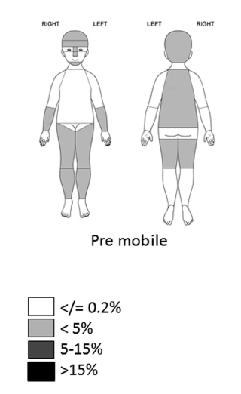

Slide 6
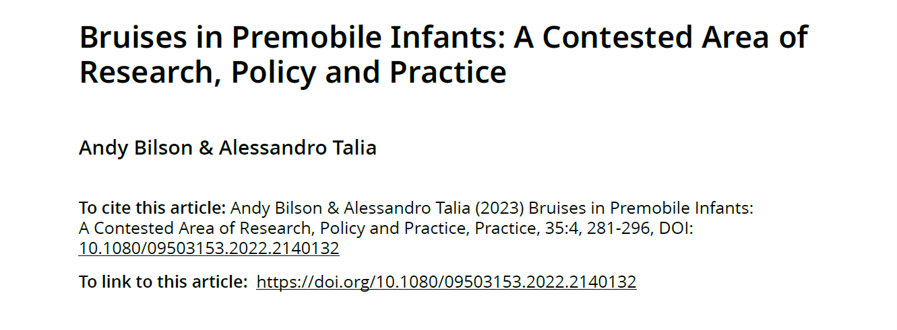

Slide 7
Range of Non-Accidental Injuries in infants
Bruising
Any bruising in an infant would be considered suspicious
Age 0---->1 year. Likelihood of NAI increases.
Inversely proportional to mobility.
Site
Pattern
Cluster, number, imprint
Face, trunk, arms and legs

Slide 8
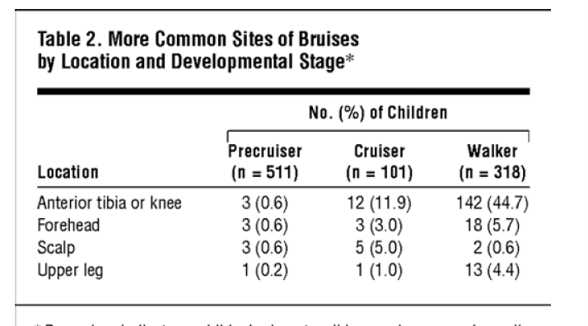

Slide 9
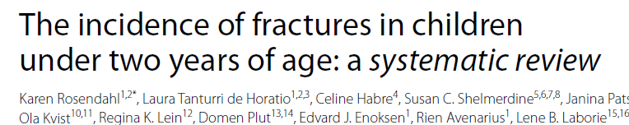
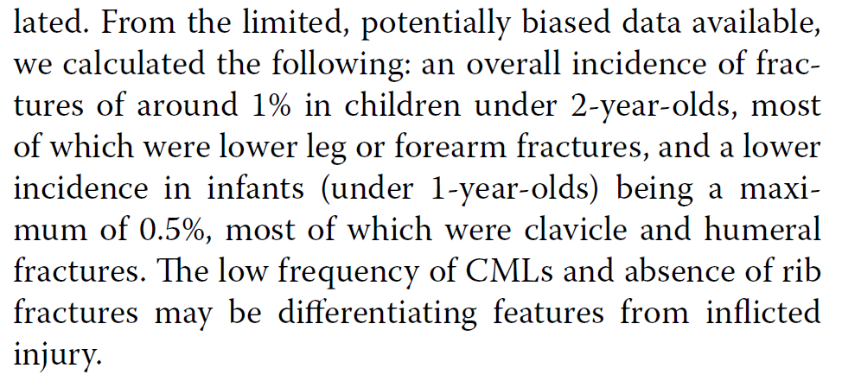

Fractures

Slide 10
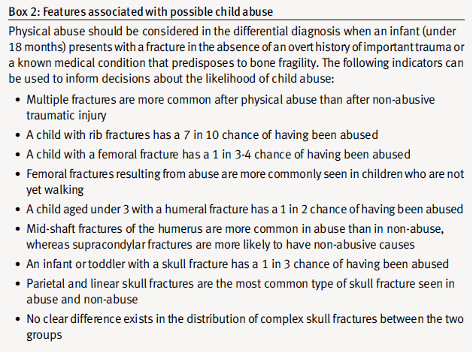
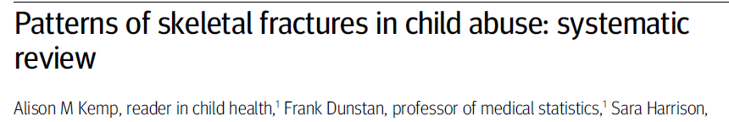
Fractures indicative of NAI

Slide 11
Fractures
Skull
Most commonly from a fall injury
Parietal bone fracture is the commonest
Parietal fractures especially linear fractures are known to occur equally from accidental and NA injuries
Bilateral fractures can occur from a single impact although rare

Slide 12
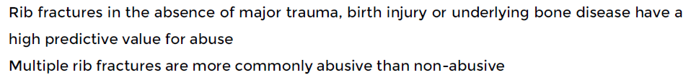
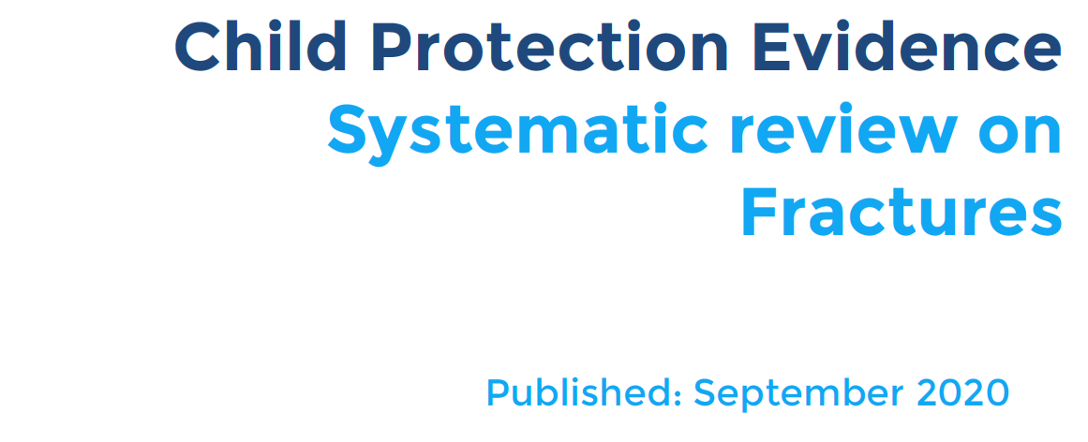
Fractures- ribs

Slide 13
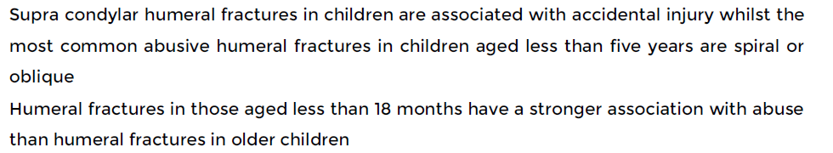
Fractures
Humerus
Femur

Slide 14
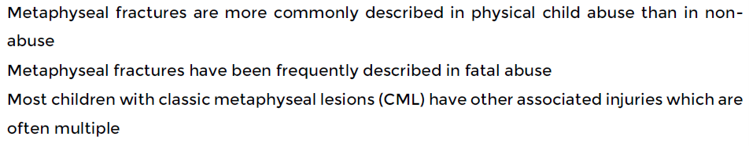
Fractures
Metaphyseal fractures of the long bones

Slide 15
Abusive Head Trauma
Shaking/ Shaking-impact injury causing
  Sub-dural haemorrhages/ collections
  Sub-arachnoid haemorrhages
  Torn bridging veins
  Thrombosed cortical veins
  Cerebral contusion
  Cerebral parenchymal injury
  With or without skull fracture
  Retinal Haemorrhages
  Spinal haemorrhage

Slide 16
Other injuries
Bite injury
Intraoral injuries
Burns and scalds

Slide 17
Questions?

Slide 18
Thank you!

