Slide 1


Support for Special Guardians in Cambridgeshire and Peterborough

Slide 2
It is estimated there are 132,000 children residing in kinship care nationally.
There has an been increased focus on this important demographic reinforced through government papers and the recent publication of the Kinship Statutory Guidance (October 2024)
The experience of Kinship carers is well documented and most recently published in the Kinship Survey 2024 (Kinship charity). The survey demonstrated that approximately 73% of the respondents were grandparents, with 13% other close family members.
The survey further demonstrated that 1 in 8 carers are concerned about caring for children in the long term and were impacted significantly by the challenges of kinship care.
National Context

Slide 3
Local Context in Cambridgeshire
Cambridgeshire has a developing landscape for kinship carers. The Authority is working hard to promote children residing with those that matter most to them.
Statistically, 42 Kinship carers were considered at Fostering panel for Regulation 27 approval in 2024-2025 in comparison with 34 the previous year (an increase in 23%) when Peterborough and Cambridgeshire were combined authorities.
There has also been a significant increase in the regulation 24 population with 60 carers being supported during the 23-24 fiscal year and98 supported during 24-25 year (an increase in 68%).
In the fiscal year 2024-2025 the Authority has supported 56 new Regulation24 Kinship carers.
The Authority has seen a 100% increase in the number of Regulation 27 Kinship carers( 24 vs 48) Between April 2024 and July 2025.

Slide 4
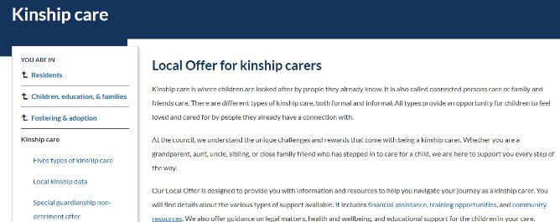

Cambridgeshire is receiving a considerable increase in requests for enhanced payments outside of policy that require Director Level discretion. We acknowledge an increase in families from lower income families and smaller accommodations.
Cambridgeshire is utilising the Form K assessment framework and SGO support plan
Cambridgeshire has worked with the DfE funded project practice guides to publish its Local Offer and has recently recruited a kinship ambassador to support with improving the Authority's response to kinship needs
Cambridgeshire has published its Local Offer and is working hard to build communities with Kinship Carers to be responsive at the first point of need and provide excellent training and support
Cambridgeshire has released a non detriment offer – this ensures that where suitable for a child there is an advanced offer of remuneration for carers who consider a Special Guardianship Offer to care for children throughout their childhood.

Slide 5
Local Context in Peterborough
We have a kinship assessment team consisting of a Team Manager, Tasalla Shaiyen and 6 assessing social workers.
In the year 2024 - 2025:
There were 93 referrals for kinship assessments during the year.
25 Connected Carer households (Kinship Carers)
28 children have achieved permanency through Special Guardianship Orders
Items heard at panel | 2024/2025 | 2023/2024 | 2022/2023
Connected Person Approvals | 23 | 12 | 6
Regulation25 Extension | 15 | 15 | 9

Slide 6
Local Context - Peterborough
Well established and active local kinship support group – with whom we meet regularly.
A kinship foster carer sits on the corporate parenting board.
The local support group has an expert by experience representative who sits on the National Kinship Care Ambassador Board, to support the Kinship Ambassador, Jahnine Davis.
A Steering Group, chaired by Tasalla Shaiyen, is developing the Kinship Local Offer – it includes kinship carers and other partners to co-design the Offer.
Kinship care is a key priority for the lead member for children's services and Senior Leaders.

Slide 7
Through the assessment the Social Worker and applicant articulates the required support both immediately and in the long term.
The Social Worker in partnership with the carer and child's Social Worker develops the SGO support plan which acknowledges the presenting and future needs
The SGO support plan including both practical and financial support is reviewed by the Team Manager and financial commitment is signed off by the Head of Service
The applicant provides relevant financial information which results in the Department of Educations financial means test.
Where an exceptional allowance is requested, in CCC a form is completed and this is sent for Director approval as it sits outside of policy. In PCC, this is considered at the Exceptional Circumstances panel, before being sent to Service Director for consideration.
The final SGO plan is shared with the carer and relevant legal parties.
Developing an effective support plan

Slide 8
The Local Offer includes (and is not limited to)
Financial support: The policy in Cambridgeshire at this time is to provide one year's means tested support for applicants who are not previously foster carers and two years for those who have cared for the child under a fostering arrangement. In Peterborough the policy is to provide the fostering allowance for two years post order for carers who previously fostered the child.
Housing: This might include adaptations needs or support in attaining a larger property
Mediation: Services for resolving family disputes promoting effective partnerships
Family Time assistance: Occasionally the service may provide long term support with family time arrangements
Training - carers are eligible to attend the full training offer and have specialist kinship courses
Referrals to the Adoption and Special Guardianship Support Fund
Targeted support services which can include parenting support, youth workers, and wider locality services and groups
Support Groups
Assistance from the Virtual School

Slide 9
Key challenges
Resource constraints: Whilst the Government has established pathfinder programs with several Local Authorities which are delivering a universal allowance, it has neither funded authorities to provide this or at this time considered a centralised benefit- ultimately this is creating a postcode lottery.
The Courts have provided a critique that the SGO support plan is too lengthy and overly generic; the need is for a more tailored and specific planning
Increased levels of need: There has been a level of increased requests made to the Local Authority- with the Local Authority caught in a tension of wanting to secure a final order considered to be in the best interests of the child and not being deprived a private family life through long term Care status
Assessment timeliness from referral and co-ordination
Meeting the requirements of the court with a suitable SGO support plan presentation

