Slide 1
Special Guardianship Orders and SGO Support Plans: Key Insights and Expectations
What Cafcass needs to see to approve a plan and key expectations for its content
18th September 2025

Slide 2
Practice Quality Standards
Cafcass have Practice Quality Standards in both Public and Private Law
The Practice Quality Standards for public law are based on our best work and set out what is expected in response to learning from feedback, audit and case reviews, and fulfil our commitment to contribute to a whole system effort to implement the recommendations of the Public Law Working Group
Practice Quality Standards guide practitioners in different aspects of practice. They set out what ‘good’ looks like, what children and families have a right to expect of us and what our family justice partners can expect of us
Practice Quality Standard 6 provides guidance on what Children’s Guardians should be looking for when considering an SGO

Slide 3
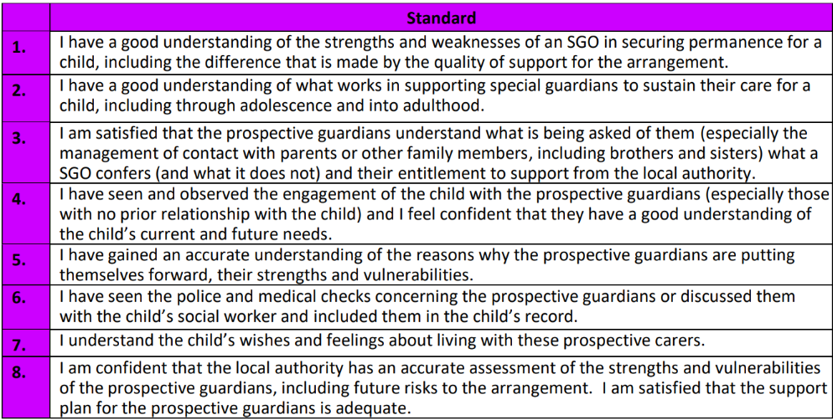
Practice Quality Standard 6 – Analysing Special Guardianship
This Practice Quality Standard is specifically to provide guidance to Children’s Guardians when a Special Guardianship is proposed

Slide 4
In practice this means.
Scrutinising the assessment to ensure it is a robust assessment that considers not only their ability to care for the children but their understanding of the circumstances and an analysis of their ability to care for each child (given their specific care needs) throughout their childhood.
Feel confident that any support needs and vulnerabilities identified in the assessment are addressed in the support plan.
Having sight of the DBS and medical checks either via the Social Worker, or the prospective Special Guardian during a visit. Without which we can’t endorse/recommend a Special Guardianship Order in the final analysis.
Being confident an appropriate ‘testing’ period of the placement has taken place including observations of the child/ren in the prospective Special Guardian’s care

Slide 5
Cont…
Ensuring the prospective Special Guardians have seen their assessment and support plan, had the opportunity to discuss this with the Social Worker and had access to their own independent legal advice. This includes discussing with the prospective Special Guardians if there is are any support needs that have not been included.
Liaising with the IRO to be satisfied they have seen the support plan and are content with it.
Thoroughly considering the support plan, to be satisfied it is personalised to that child’s specific needs, is not generic and financial offer is in line with regulations. This could mean ensuring specialist therapeutic support is in place or agreed, additional financial support over and above that of the standard offer, commitment to continuing supervision of family time arrangements or risk assessments if a parents situation changes eg upon release from prison.

Slide 6
In summary
In order to approve the plan the Children’s Guardian has to be confident the support plan.
Is robust
Is personalised
Recognises any vulnerabilities
Considers the needs of the child/ren now and throughout their childhood and adolescence

Slide 7
Useful links
Public-Law-Practice-Quality-Standards-Reviewed-March-2023-1.pdf
Publication of the President’s Public Law Working Group report | Child Protection Resource

