Slide 1
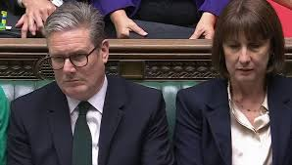

ADR - NCDR
And other ways to cut the MOJ budget
- and eat more biscuits ?
Richard Balchin, Barrister - June 2025

Slide 2
ENE
Early Neutral Evaluation
£

Slide 3
pFDR
Private FDR
£££

Slide 4
pFDR
Arbitration
££££

Slide 5
Counsel’s Advice
£

