Slide 1







Planning Together for Children
Notes:
Hayley- Add logos on from all Sub contractors also

Slide 2

What is Planning Together for Children…
Planning Together for Children is an England-wide online course. It supports parents who are separating or living apart to put the needs and best interests of their children first.
Parents will learn how to protect their children against some of the harmful effects that can arise due to parental conflict.
During the course, parents, or those who care for children, will:
Explore how they can work together to agree on parenting arrangements without the need for more court hearings.
Learn how disagreements and arguments can affect children, so they can minimise them.
Planning Together for Children Replaces the Separated Parenting Information Programme (SPIP), the programme made up of online learning- then interactive live digital group sessions- then impact feedback collected.

Slide 3
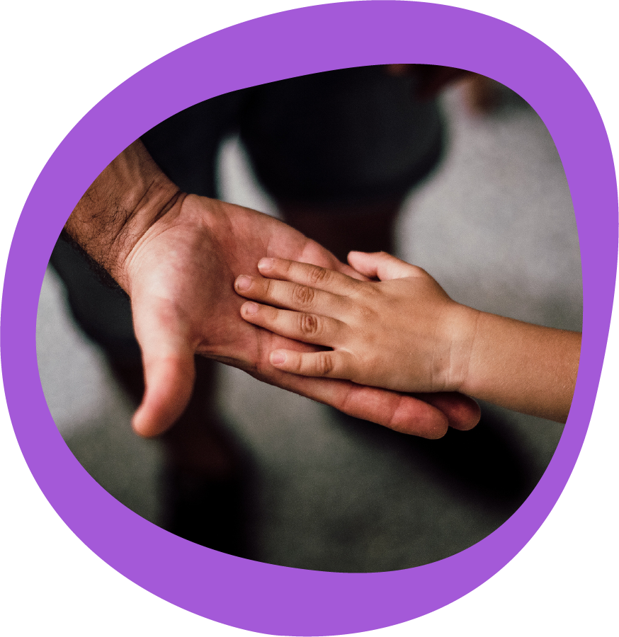
Aim’s of Planning Together for Children
Protect children against some of the harmful effects of parental conflict
Gives more time for engagement and reflection by participants
The impact of the course is recorded so things can be adapted over time.
Aims to reduce the time families spend in court proceedings
Aims to reduce the number of families returning to court

Slide 4
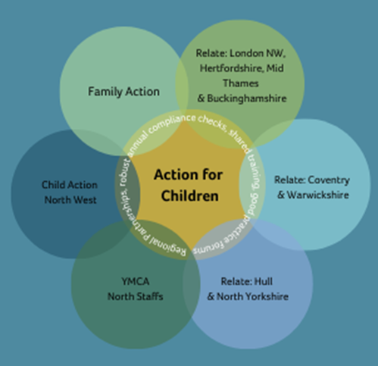


Who delivers Planning Together for Children?
Contract led by Action for Children in collaboration with its delivery partners
6 Sub-contractors delivering UK wide.
Each provider follow the same course content and follows the programme fidelity.
All attendees get same experience.

Slide 5
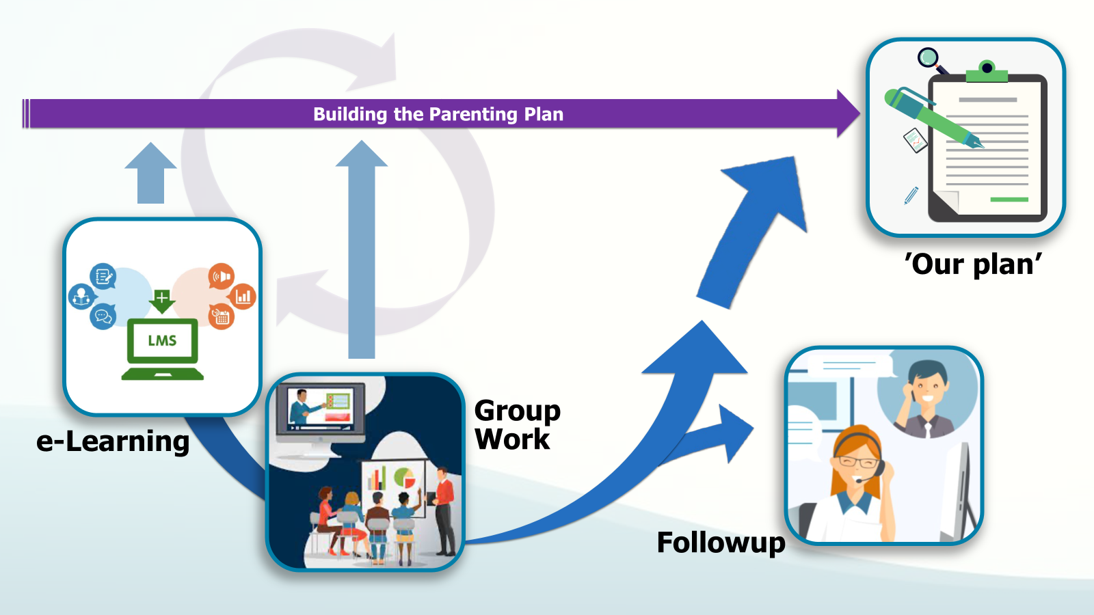
Programme Journey
Notes:
The new model takes on board all the consultation and learning undertaken

Slide 6
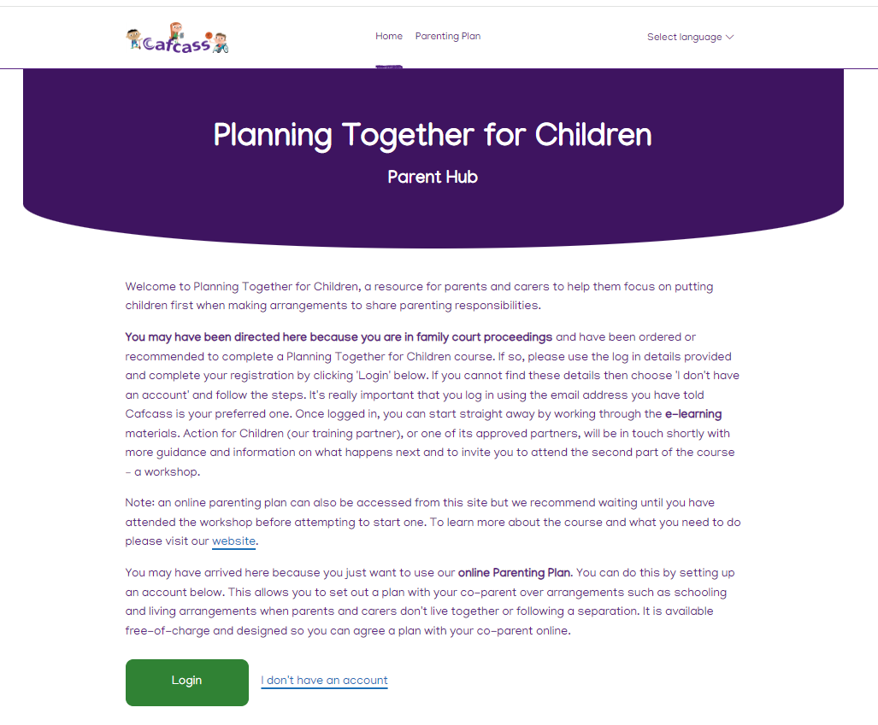
Stage 1
Welcome email from Cafcass and Provider
Participant logs on and complete eLearning independently
Notes:
Parent Hub front page

Slide 7

Stage 1
Survey:
Tell us how you are feeling before you start
Welcome and introduction
Survey:
Tell us how you have found the e-learning
8. What am I going to do next?
1. What happens if I go to court?
7. Tips to help me remember how to listen, talk and communicate in the future
2. Understanding and managing emotions and feelings better
6. How can I listen and communicate better to help my child
3. How does the way we handle our separation affect my child/children?
4. Putting myself in my child’s shoes
5. What can I and my co-parent do differently to support our children?
Survey:
Tell us how your learning is going
Notes:
These are the modules. There are 3 survey points during the e-learning.

Slide 8
New- Planning Together for Children Professionals briefing new logo's 2526.pptx

Slide 9
eLearning Access for Professionals
Cafcass colleagues and members of the judiciary can now access the eLearning for Planning Together for Children. The eLearning is the first part of the course that parents are asked to complete before they are invited to attend an online group session with up to five other learners.
Why is this happening?
It is hoped that access to the eLearning will help Family Court Advisers and members of the judiciary better understand the content of the course and see what parents experience when they are referred to Planning Together for Children.
What is in the eLearning?
There are nine sections to complete within the eLearning: each taking around 10 minutes. The eLearning focuses on topics such as: what happens if parents go to court, understanding and managing emotion, how separation affects children, how to listen and communicate better, and looking at things from a child’s point of view.
How do I gain access?
A temporary login can be used to access the eLearning, where you will be asked to enter your Cafcass email address. A ‘one-time link’ will be sent to your inbox.
This access is temporary, so if you are completing modules over different days, you will need to request a new link.
Notes:
After log in slide- what it looks like

Slide 10




Group Work
Once eLearning complete
Not on programme with co-parent
Online delivery with 6 other parents/ carers
Providers can support individual needs where required
Once completed feedback is submitted directly to Cafcass with option to opt in for a Stage 3 Call.
Stage 2
Notes:
Feedback from Cafcass: Right at the start about check in with participants what is meant by conflict – it is more than arguments and
shouting, it needs to be expanded upon so parents understand it is about other things like having very different
routines and values in households, the non-verbal communication with one another, the lack of communication.
Conflict is a strong theme so the first thing to tackle is making sure everyone fully understands what is meant by
It
High conflict is on-going and unresolved arguments and disagreements that usually leaves someone upset, angry, and hurt. This is constant, you may feel that your under attack or can't see an future where things might be better.
Low conflict is when you initially don’t agree or have a different opinion, and you might feel stuck. However, the situation is often resolved through communicaiton and willingness to understand the other, low conflict is normal in relationships.

Slide 11
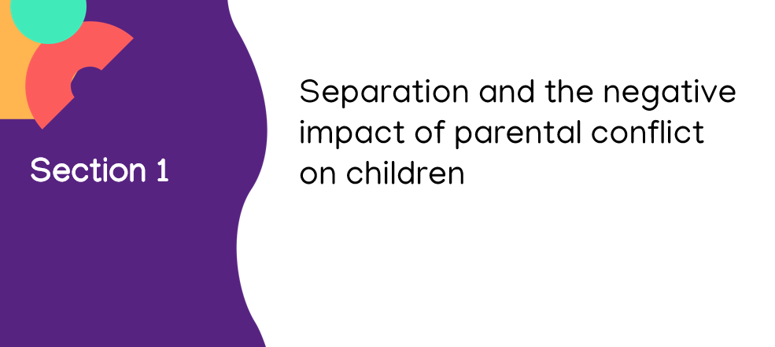
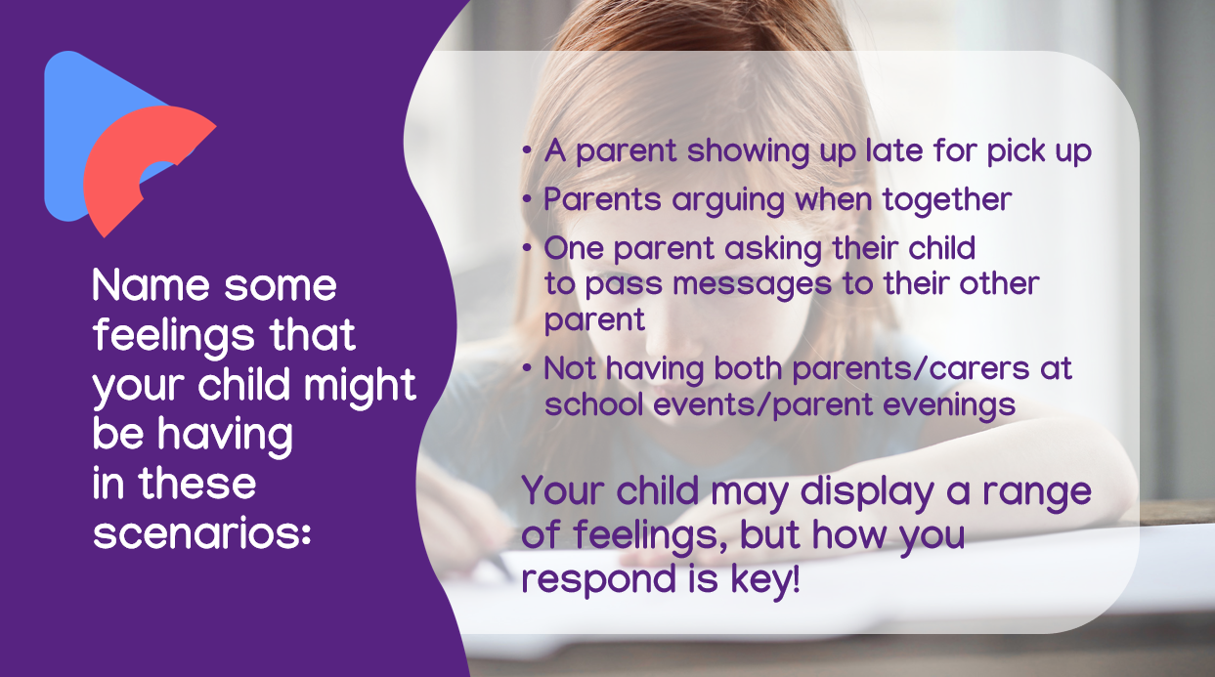
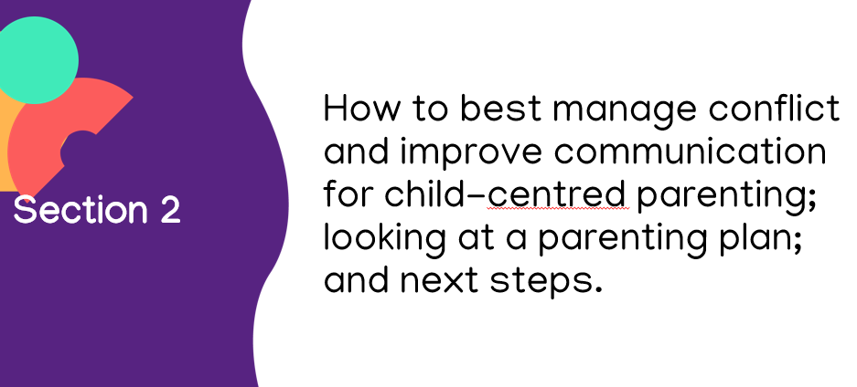
Group Work
Stage 2
Notes:
Workshop is broken into two parts.

Slide 12
Group work programme- with vids embed May 24.pptx

Slide 13
Group work programme- with vids embed May 24.pptx

Slide 14
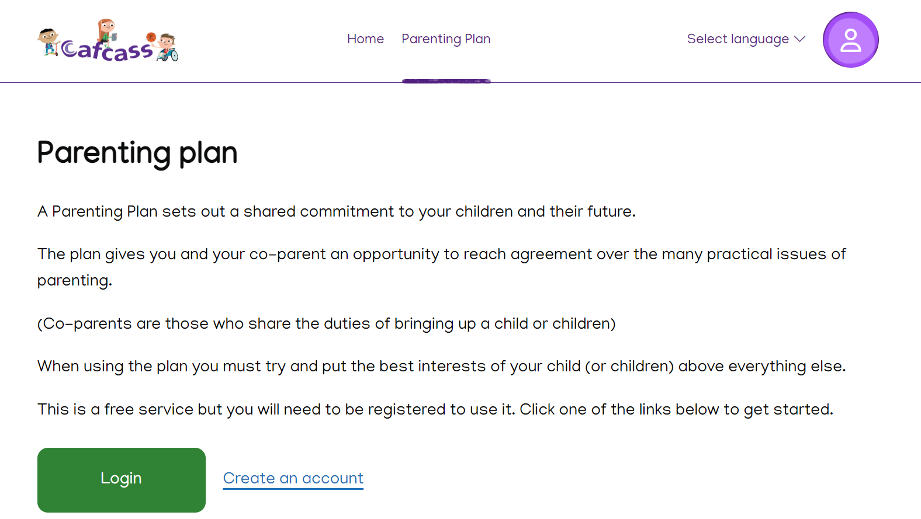
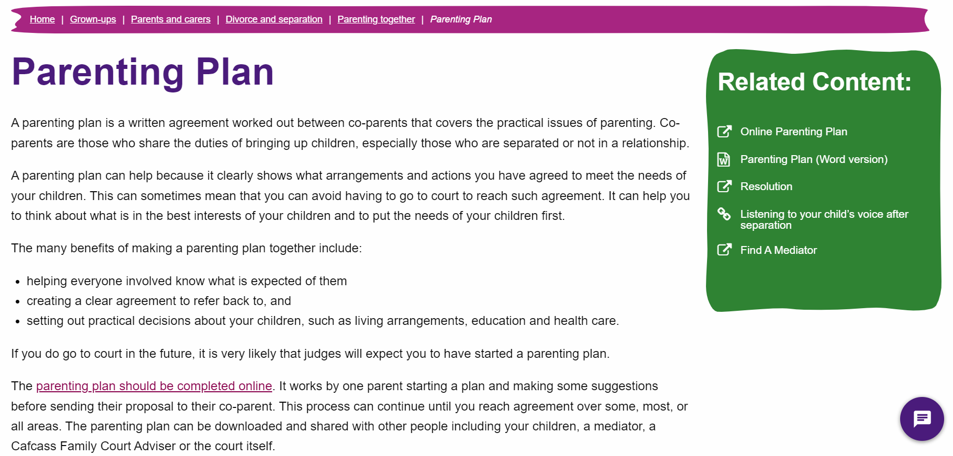

Parenting Plan

Slide 15
Important to note- Parenting Plan
The parenting plan is not a mandatory part of the course.
It should not be completed if there are ongoing safeguarding concerns or risks of domestic abuse.
Ideally, if it is appropriate to complete a plan this should come at the end of the learning journey – the trainer can advise and support on this.

Slide 16
How is a referral made?
Recommended by a Family Court Advisers
or
b) Following a court order. Court orders can continue to be sent to Cafcass at planningtogether@cafcass.gov.uk
This replaces SPIP_Records and SPIP_Referrals email addresses.
Who can be referred?
Planning Together for Children is for parents and adults with caring responsibilities in Private Law Family Court proceedings.
Notes:
Hayley- Important to keep, does it need more detail?

Slide 17

What can you do to support Parents and Carers?
Ensure contact details are completed on referrals including phone number, email and postal address.
Encourage parents to verify those details with Cafcass.
Make participants aware of expectations and encourage through each stage.
Share as much information about the session before to parents and carers who are expected to attend.

Slide 18
Domestic Abuse and support for participants
The majority of cases where Domestic Abuse has been assessed within proceedings, conclude with some form of contact including letterbox, video call, supervised, supported or unsupervised arrangements.
It is therefore likely that those attending PTfC, even if Domestic Abuse is a concern, will need to safely manage future arrangements for their child or children.
Cases should only be recommend if there is a reasonable likelihood that the parents will need to communicate regarding their children now or in the future.
Cases Should not recommend or refer to PTfC when:
There are significant allegations that if proven, would preclude any form of safe contact
It is assessed that the impact of trauma on the victim is such that they could not support any form of contact with the perpetrator
The child’s wishes and feelings are determinative, and they would resist any form of contact
The court may direct attendance at PTfC without a recommendation from Cafcass. The court have received guidance about when it is not appropriate for parents to attend PTfC

Slide 19
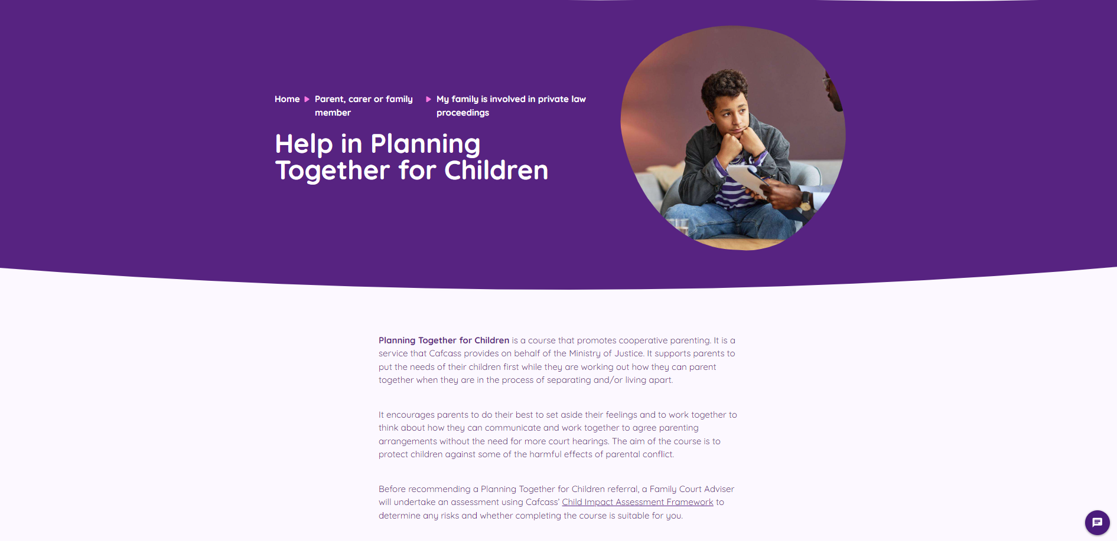
Thank you for attending today.
Kerry Moss- Parental support Co-ordinator
Sarah Burfield – Service Co-ordinator
Rebecka Kisnorbo – Service Co-ordinator
Hayley Paterson – Children Service Manager
Action for Children
Planningtogetherforchildren@actionforchildren.org.uk
Help in Planning Together for Children | Cafcass

