Slide 1
Paediatric Traumatic Brain Injury: Clinical Insights and Medico-Legal Considerations
Ibrahim Jalloh PhD FRCS (SN)
Consultant Neurosurgeon, Cambridge University Hospitals, UK
Clinical Lead Paediatric Neuro-oncology Rehabilitation (Brainbow)
Fellow and Clinical DOS, Homerton College, Cambridge
June 2025

Slide 2
Talk outline
1. TBI Pathophysiology
2. Infant TBI
Skull fractures, SDH, hypoxic-ischaemic injury
3. Clinical versus expert

Slide 3
1. TBI Pathophysiology

Slide 4

Children are not young adults
Diffuse injuries – younger children
Focal mass lesions – older children
Larger head mass
Weak cervical musculature
Pliable skull
Metabolism, neurobiology
Notes:
There are important differences between adults and children. It is inappropriate to extrapolate our experiences of adult traumatic brain injury (TBI) to paediatric patients.
Firstly, the mechanisms that cause TBI vary depending on age. For instance, NAI in infants which is a diffuse and repetitive injury is quite different to the falls, skateboard and road accidents that are more common in older children.
Secondly, constitutional factors in children result in different injuries based on age. Children have proportionally large heads, weak neck muscles, more pliable skulls, and age dependent differences in the behaviour of cerebrospinal fluid and other neurobiological differences that impact the physiology of TBI.

Slide 5
TBI is a heterogenous disease
Mechanism
Closed
Open
High Velocity
Low Velocity
Repetitive
Gunshot
Other
Falls
Assault
NAI
RTA
Notes:
TBI is a very heterogenous disease and therefore it’s helpful in terms of treating it and predicting outcomes to categorise it, which can be done on the basis of mechanism in terms of

Slide 6
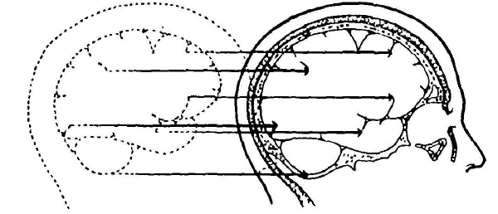
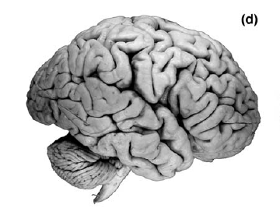
TBI is a heterogenous disease
Morphology
Skull Fracture
Intracranial Injury
Base
Vault
Diffuse
Focal
Haematoma
Contusion
Linear
Depressed
+/- CSF leak
Extradural
Subdural
Intracerebral
Notes:
The lesion or lesions associated with the TBI such as…

Slide 7
TBI is a heterogenous disease
Feature | Score
Eyes Spontaneous Opening Open to Speech Open to Pain No Response | 4 3 2 1
Verbal Alert, babbles, coos, words or sentences to usual ability Less than usual ability Cries to pain Moans to pain No Response | 5 4 3 2 1
Motor Normal spontaneous movements Localising Flexion Abnormal Flexion Extension No Response | 6 5 4 3 2 1
Severity
Mild
Moderate
Severe
GCS 13-15
GCS 9-12
GCS <8
Notes:
Very useful in terms of predicting outcomes, is the Glasgow Coma Score, which is a scale of consciousness…

Slide 8
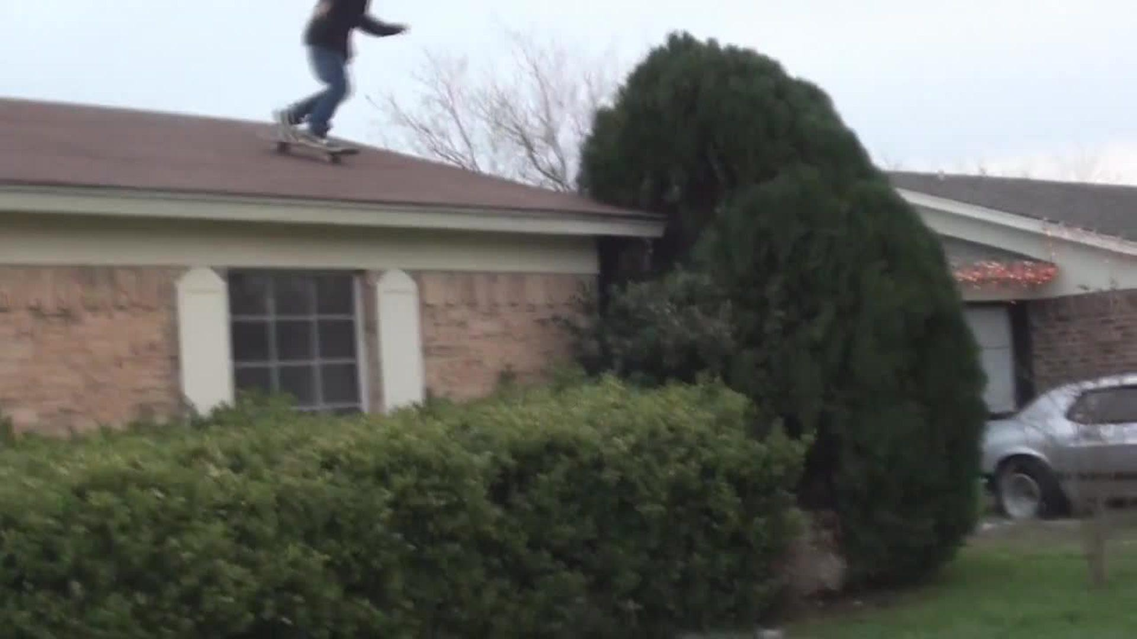
We can’t do anything about the primary injury.
Notes:
Clearly there’s only so much we can do about the primary injury i.e., the moment the head impacts the ground or the motorway pile up, or the whole catalogue of silly injuries that we see is kids, from…
Car surfing
Climbing abandoned warehouses
E-scooter stunts
And worse of all, horse-riding

Slide 9
We can’t do anything about the primary injury.
Primary Injury
Secondary Injury
  Raised Intracranial Pressure
  Hypoxia
  Hypotension
  Hyperthermia
  Inflammation
  Seizures
  Excitotoxicity
PREVENTABLE
Notes:
So the management is geared towards minimising and preventing the secondary injury that evolves following the episode of physical trauma.
This secondary injury involves a whole host of mechanisms including…
Raised intracranial pressure from brain swelling or blood clots that impedes the normal blood flow in the brain
Often head trauma can affect a patient’s breathing and systemic circulation, further reducing blood flow to the brain.
Hyperthermia and inflammatory mediators can increase the metabolic demand of the brain further causing it to outstrip its supply.
Similarly, seizures can have profound effects on brain metabolism.
Excitoticity is a mechanism where burst cells release all their neurotransmitters activating the neurons, further increasing the demands when the supplies can’t get there.
Ultimately, if left unabated, these mechanisms lead to death of brain tissue.

Slide 10
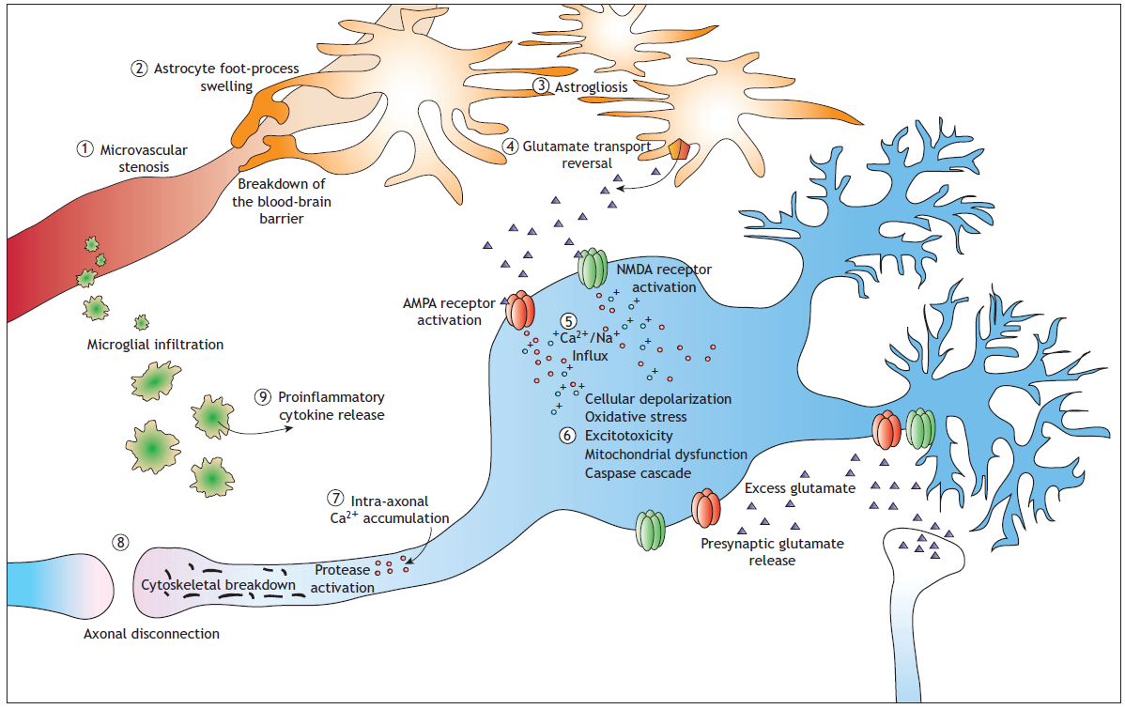
We can’t do anything about the primary injury.
PREVENTABLE
Notes:
Many of these mechanisms amplify each other, working in vicious cycles for example narrowing of blood vessels causes the support brain cells to swell, which then means they can’t clear up spent neurotransmitters, which then activate cells that are already stressed, which causes them to break down releasing inflammatory mediators that cause further narrowing of blood vessels. It really is a perfect thunderstorm that can propagate through out the brain.

Slide 11
2. Infant TBI

Slide 12
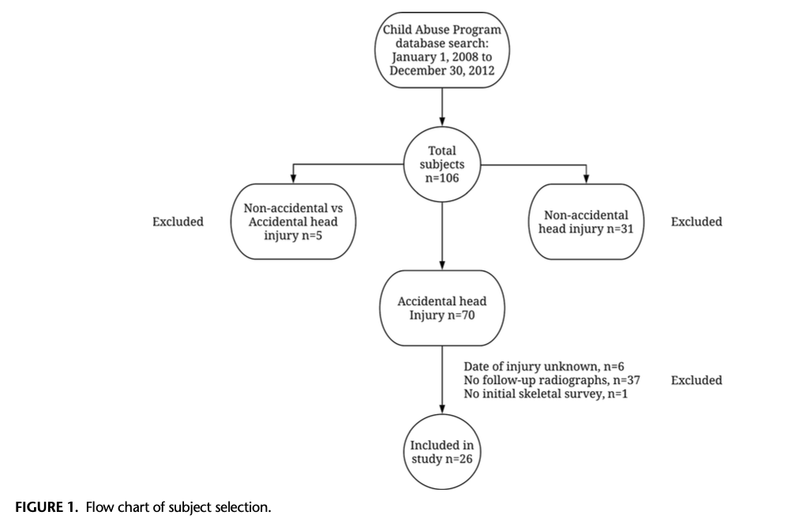
Skull fractures are common after accidental falls
Typical response
  Cry/look stunned
  Comfort easy
  Mild ‘concussion’
  Scalp lump
Notes:
Skull fractures are actually quite common
On average I see one infant per week with a skull fracture
The typical story is a fall from a change table
The typical clinical response is usually quite mild.

Slide 13
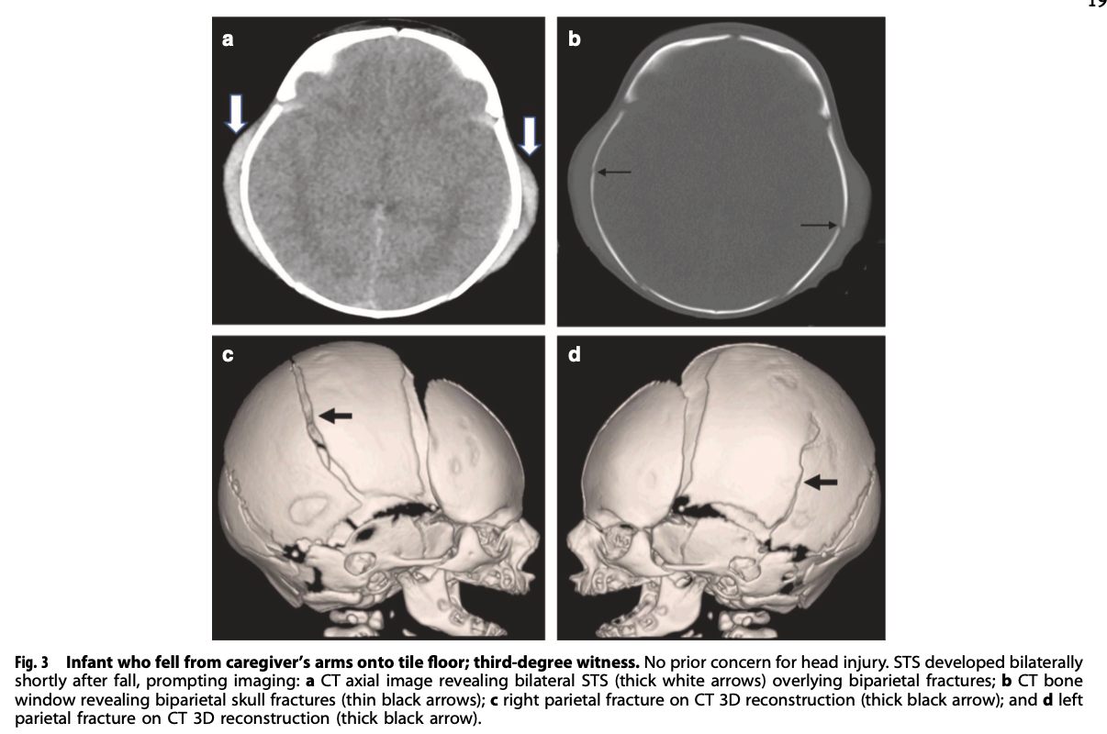
Fracture complexity does not necessarily corelate with abuse
Structural characteristics of younger infant skulls ~ more complex fractures
Notes:
Sometimes fracture complexity is used to determine the likelihood of NAI with more complex fractures

Slide 14
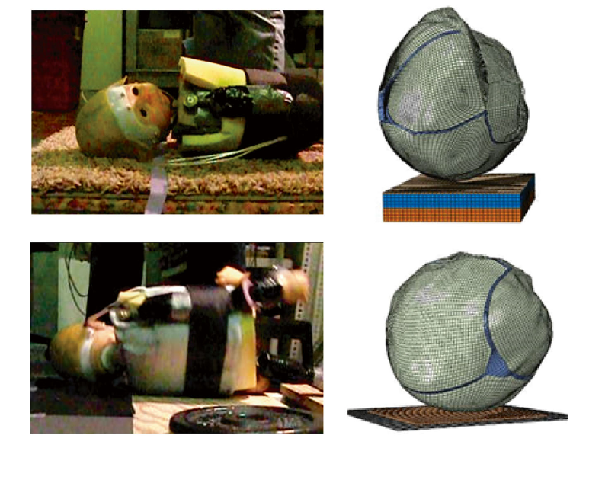
Threshold height to fracture skull
Notes:
Whether a short-distance household fall is sufficient to cause a fracture will depend on various factors (that are difficult to quantify) including the height of the fall, the hardness of the surface, the child’s position as they fall and land, the motion of the body during the fall, and the position and mass
of the head.
Scientific studies addressing this question, which consist of case reports, retrospective clinical reviews, and modelled scenarios using cadaveric skulls and mathematical models, suggest that falls from as low as 0.3m will rarely, but very occasionally, result in a skull fracture and that the probability of fracturing the skull from a fall of 1m onto a hard surface is actually quite high.

Slide 15
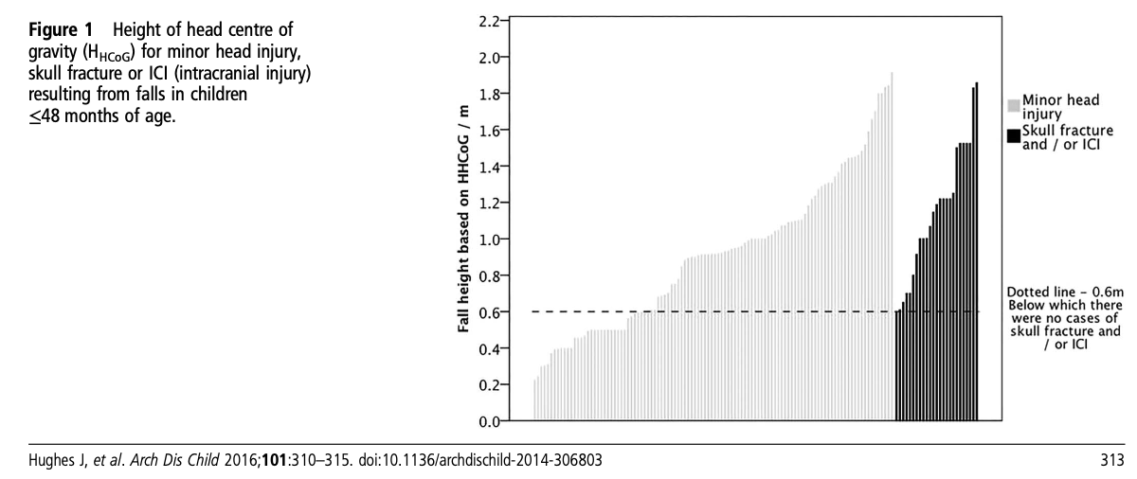
Threshold height to fracture skull
Notes:
The real world threshold height is 0.5 to 0.6 m

Slide 16
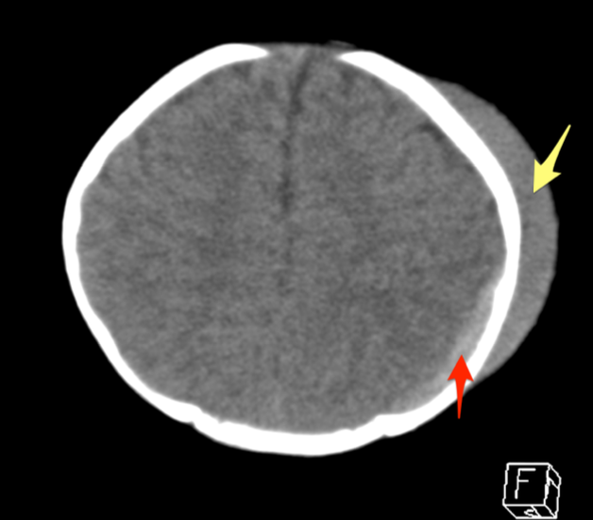
Fracture ageing
Scalp swelling
  Onset hrs to days
  Lasts 2 wks
Associated intracranial haemorrhage
  Acute (white) blood on CT < 11d
Notes:
The features that are useful in ageing a skull fracture are

Slide 17
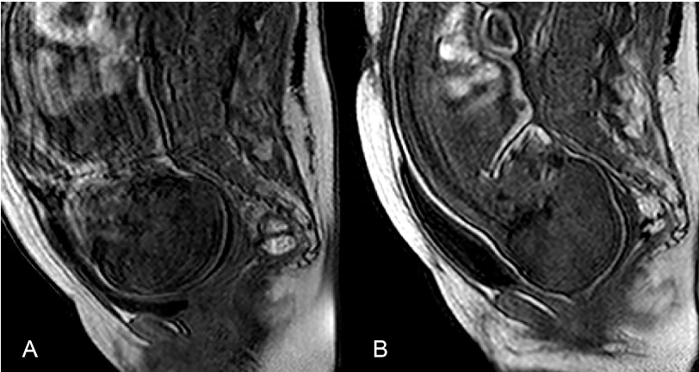
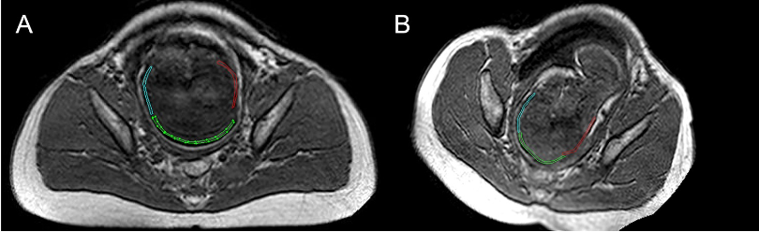
Fractures due to birth trauma
0.02 - 0.06 per 1000 births
Spontaneous VD +/- forceps/vacuum
Clinical signs at birth
  scalp swelling, cephalohaematoma
  Brain injury
Notes:
There are several large, relatively recent (published since 2000) population-
based studies that give an incidence of 0.02 - 0.06 per 1000 births.
skull fractures can be caused by birth
trauma including spontaneous vaginal delivery without the use of forceps or
vacuum to assist delivery.

Slide 18
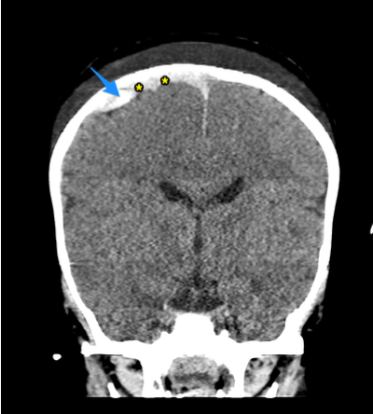
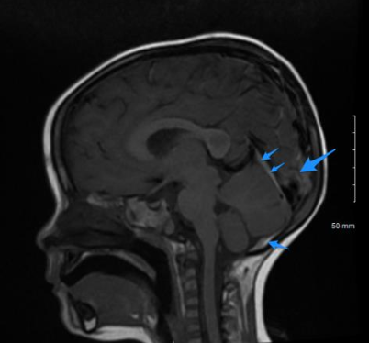
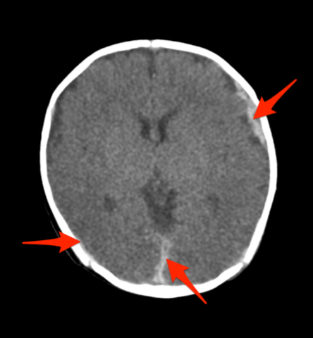
Focal versus multi-focal subdural collections
  Focal
  Impact
  Multi-focal
  Diffuse injury
  Acceleration-deceleration
  Shaking, car accidents
Notes:
Probably the most important aspect in determining cause of subdural bleeds is there distribution

Slide 19
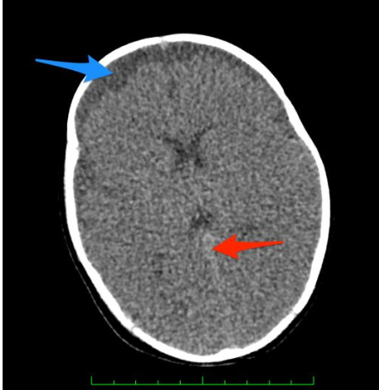
NAI subdural collections often low volume
Interhemispheric
Multi-focal
Associated with hypoxic-ischaemic changes (brain swelling)
Notes:
Important to note that SDH associated with abusive NAI are typically low volume

Slide 20
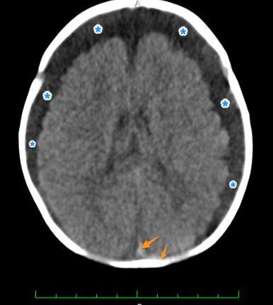
Subdural collections contain blood and CSF
Subdural haematoma
Subdural effusion
Subdural haematohygroma
Subdural collection
CSF leaks via tears in arachnoid membrane

Slide 21
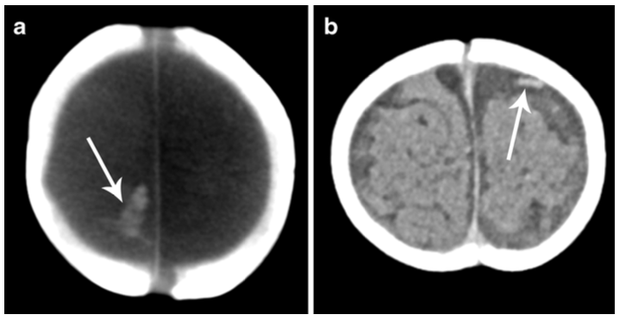
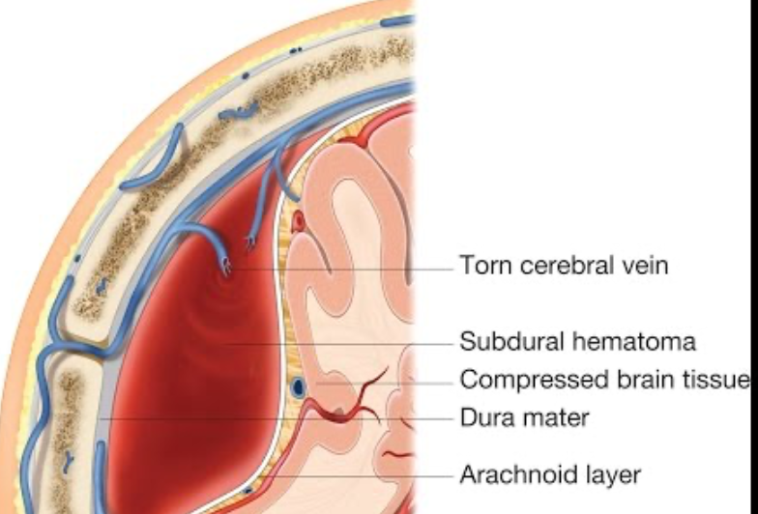
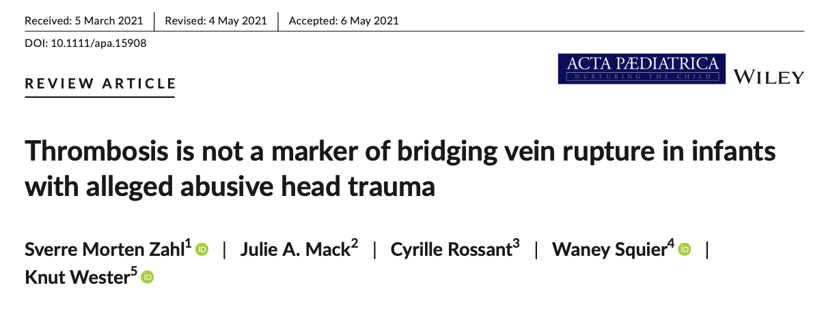
Subdural bleeds caused by torn bridging veins
Notes:
Bridging veins cross from the surface of the brain to large draining veins in the midline of the head that are relatively fixed to the skull. Tearing of bridging veins is thought to be the primary cause of subdural and subarachnoid bleeding in traumatic brain injury in infants. Torn/damaged bridging veins are
seen as thrombosed bridging veins on scans.
Acceleration-deceleration forces that cause the brain to move relative to the skull will tear veins. The acceleration-deceleration forces associated with a shaking injury will readily tear veins, frequently on both sides of the head.
impact type injury will be of sufficient force/energy to cause inertial acceleration-deceleration of the brain that can also tear veins.

Slide 22
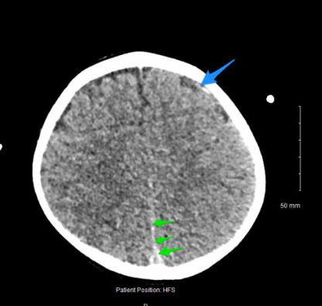
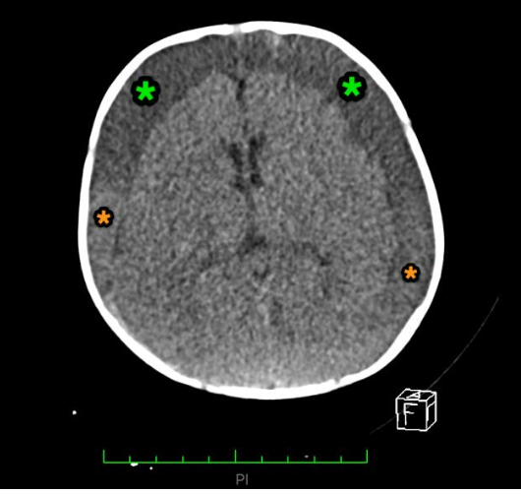
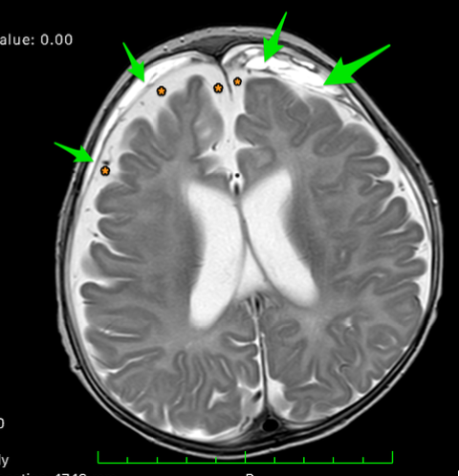
Acute versus chronic subdural collections
Acute blood white on CT < 11d
Chronic collections
  Membranes > 2 weeks
  Large volume

Slide 23
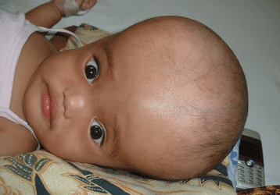
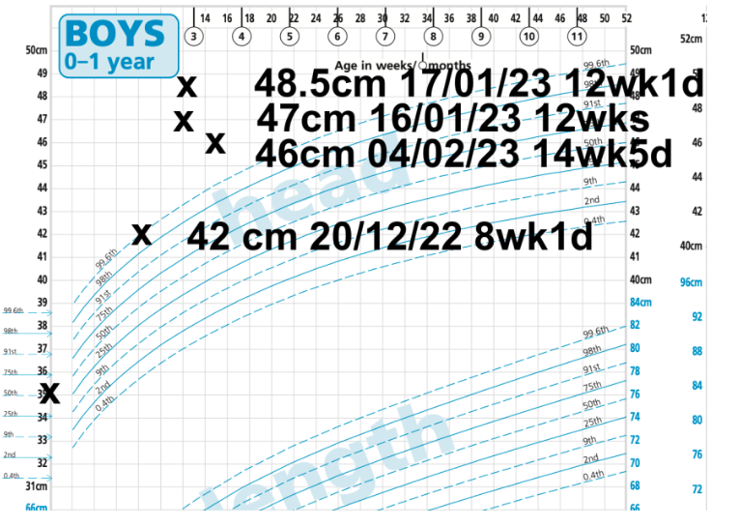
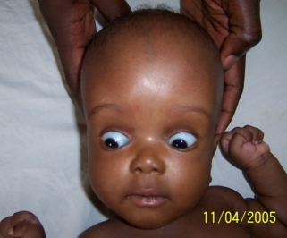
Head circumference sometimes the only clue

Slide 24
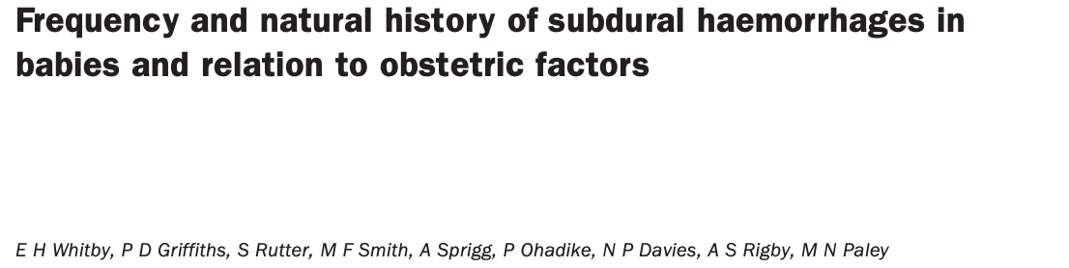
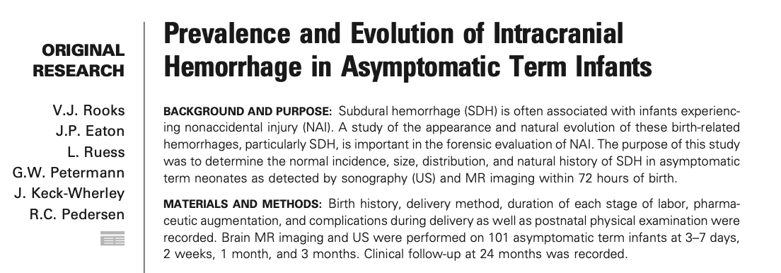
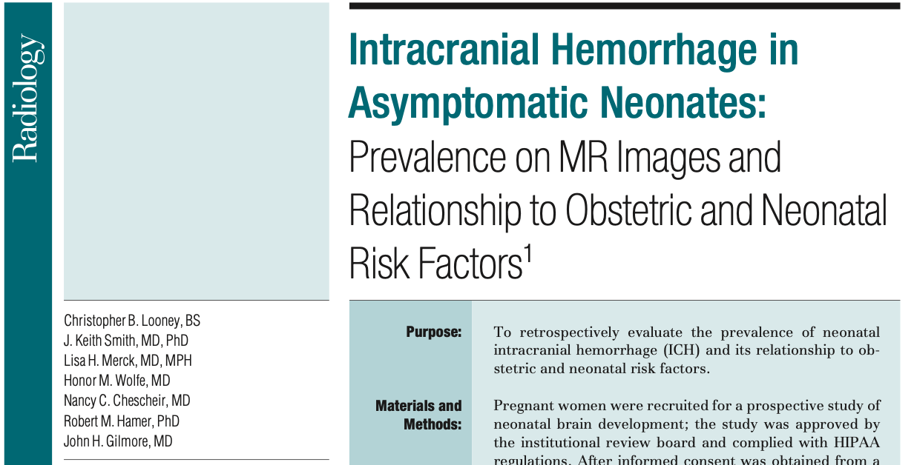
Birth-related subdural bleeds are common
Resolve by 4-6 weeks
Back of head
Notes:
Rooks et al, 46 of 101 infants were found to have evidence of subdural
haemorrhage on MRI performed within 72h of birth. The subdural haemorrhage was
most commonly located at the back of the head. 18 of 46 had follow-up imaging
showing resolution of the subdural haemorrhage at 3 months, and most of these
(15/16) actually had resolved by 1 month.
Whitby et al, 9 of 111 babies were found to have clinically silent
subdural haemorrhage which were all located towards the back of the head. All of
these had resolved by 4 weeks. A less sensitive MRI scanner was used in this study
compared to the Rooks et al study.
Looney et al, using a high strength MRI scanner similar to Rooks et al, found
haemorrhage in 17 of 97 infants scanned between 1 and 5 weeks after birth,
including 2 infants with subarachnoid haemorrhage.

Slide 25
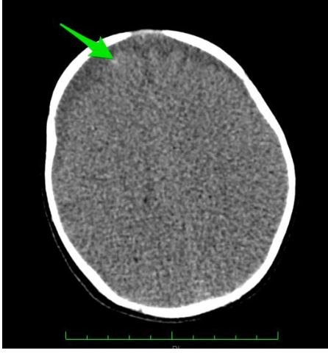
Hypoxic-ischaemic injury
Radiology
Clinically – encephalopathy
  Not right
  Irritability
  Abnormal movements
  Seizures
  Limp/floppy
  Apnoea
  Pallor, mottled
  Deep coma
  Death

Slide 26
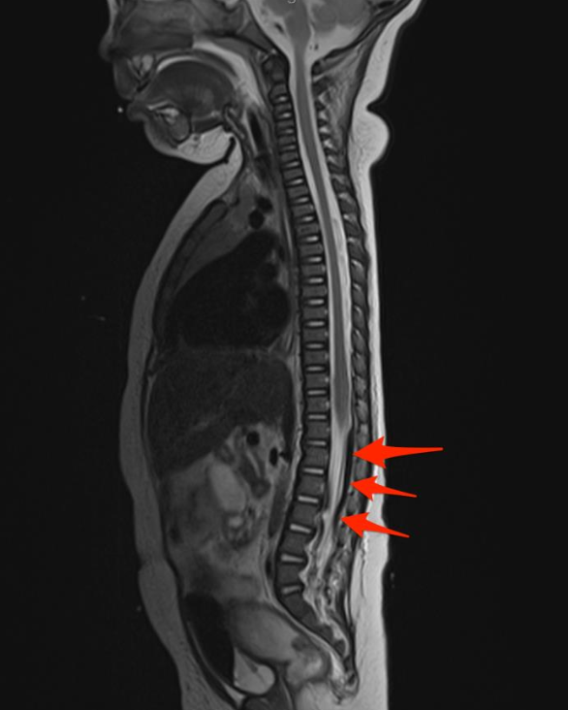
Unclear origin of spinal subdural blood
40-60% of infants with NAI
More common in NAI (as far as we know)
?redistribution from head

Slide 27
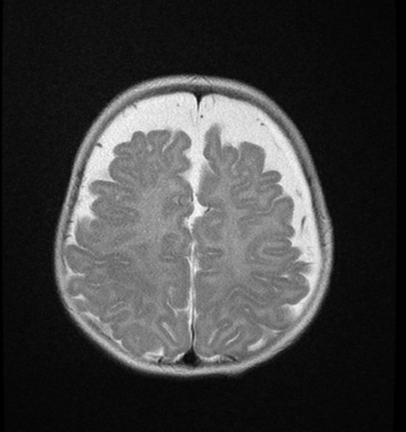
BESSI is likely a risk factor for subdural collections
BESSI
  Enlarged extra-axial cerebrospinal fluid (CSF) spaces
  Prematurity
  More common in boys
  Neuro-developmental disorders such as glutaric aciduria type 1
  Benign course when idiopathic
  Increased risk of SDH

Slide 28
3. Clinical vs legal

Slide 29


Infant TBI causality
Differential diagnosis
Differential aetiology
determine the nature of a patient’s illness for purposes of diagnosis and treatment
takes the diagnosis of the patient’s condition and then determine the cause
Both methods require process of elimination reasoning.
We rarely pursue the question of cause when treating patients.
Notes:
differential diagnosis is the process whereby medical practitioners determine the nature of a patient’s illness for purposes of diagnosis and possible treatment.
What is the likely cause or differential etiology
Both methods require process of elimination reasoning, but they lead to two fundamentally different determinations: Differential diagnosis is used to diagnose the patient’s condition, while differential etiology takes the diagnosis of the patient’s condition as a given and then uses the basic technique of elimination to determine the cause of the patient’s diagnosed condition.
Although the distinction may seem slight, the implications are far-reaching. From a practical standpoint, doctors regularly engage differential diagnosis to identify the disease or illness responsible for the patient’s symptoms. Once the illness is identified the physician can determine the most appropriate treatment, i.e., additional testing, medication, or surgery.[14] Because physicians are primarily concerned with diagnosis and treatment, they rarely pursue the question of what caused the illness or disease, because in the medical context, the cause of the disease is irrelevant.
Thrombosed bridging veins

Slide 30
Differential aetiology – working backwards
Simple skull fracture
Multi-focal subdural collections + interhemispheric blood + hypoxic-ischaemic injury + spine subdural
Complex skull fracture
Focal subdural bleed
Multi-focal subdural collections + interhemispheric blood
Hypoxic-ischaemic injury
Subdural collection + BESSI
NAI
Notes:
And this mirrors much of what I’ve presented thus far. We have the diagnoses (the skull fracture, the subdural bleed) and we work backwards to determine cause.
As a summary to the principal lesions associated with infant TBI, this is my general schema of their likelihood of being caused by NAI
So in general, multi-focal SHD + … is much more likely to be caused by NAI compared to say a simple skull fracture. This is of course without considering any other factors

Slide 31
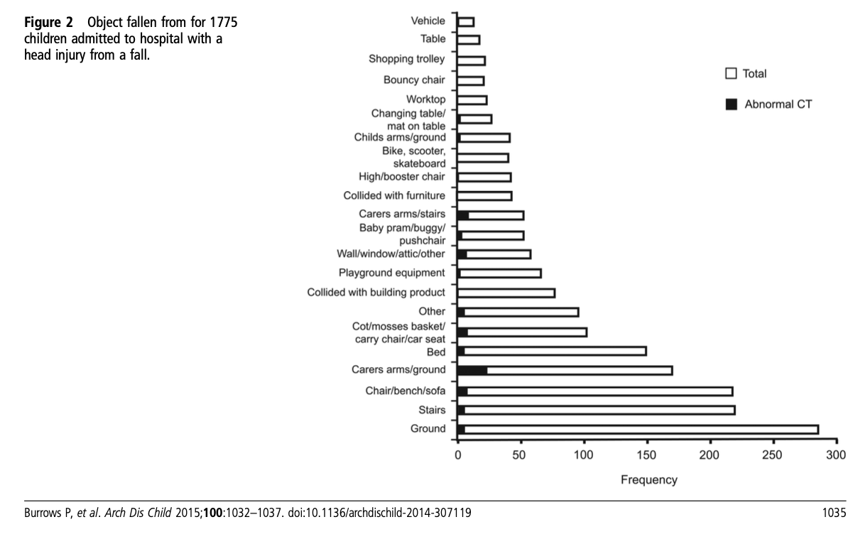
Differential diagnosis – working forwards
Falls
  Skull fracture
  Focal ICH
  (multi-focal ICH)
  (hypoxic-ischaemic injury)
  (death)
Notes:
Taught that 80% of understanding what’s wrong with a patient is from the history
And so working forwards, considering the histories given by parents and their consistency with the diagnosis, we have consider the proposed mechanism of accidental injury.
Most commonly falls. From retrospective studies and also from my clinical experience, we know that infants that are dropped frequently suffer skull fractures and or intracranial haemorrhage.
One of the difficulties in determining cause is that occasionally a simple fall will cause multi-focal ICH..

Slide 32
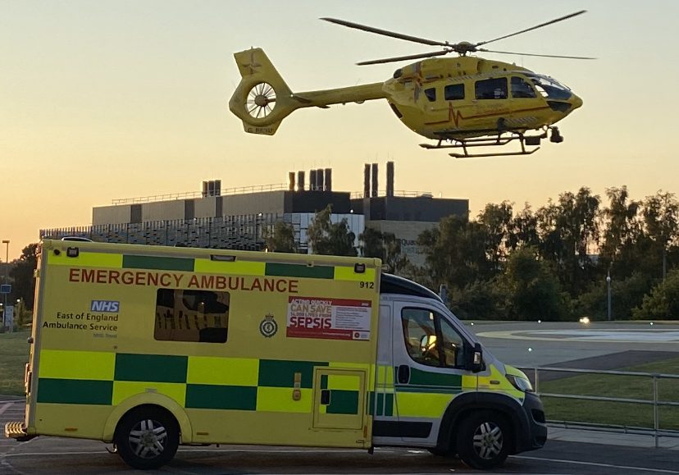
Differential diagnosis – working forwards
Clinically – encephalopathy
  Not right
  Irritability
  Abnormal movements
  Seizures
  Limp/floppy
  Apnoea
  Pallor, mottled
  Deep coma
  Death
Notes:
I’ve already discussed the features of encephalopathy that characterize shaking injury.
Often the description of the clinical presentation before the ambulance is called can give some clues as to the timing of a brain injury. Typically when an infant presents collapsed for example not breathing associated with a floppy episode, the likelihood is that the episode of trauma that caused the brain injury occurred in the moments before the collapse, within minutes of the paramedics being called.

Slide 33
Differential diagnosis – working forwards
BRUE
  apparent life-threatening event (ALTE)
  Brief resolved unexplained event (BRUE)
a brief (< 1 min) episode characterized by one or more of the following:
  cyanosis or pallor,
  change in muscle tone (increased or decreased),
  change in responsiveness,
  absent, irregular, or decreased breathing
Notes:
However, features of encephalopathy overlap with BRUE

Slide 34
Differential diagnosis – working forwards
BRUE
  apparent life-threatening event (ALTE)
  Brief resolved unexplained event (BRUE)
HIE e.g. choking does not cause significant SDH
?resuscitative shakes
Notes:
But inherent to what happens with a BRUE is that it is transient, which distinguishes it from encephalopathy associated with a brain injury.
Sometimes a carer will explain that they shook an infant in response to a BRUE like episode.
And that there is one of the boundary lines of the medical evidence as it is conceivable that a caregiver shaking an infant in panic might cause a similar pattern of injury to a caregiver that shakes an infant out of frustration

Slide 35
Challenges in determining cause from the medical evidence alone
NAI
ACCIDENT
Multifocal SDH
History of plausible household fall but rare outcome of such a fall
Population level statistics – shaking much more likely
Notes:
Often I’m asked to give a degree of likelihood for a particular cause of a brain injury in a particular child.
However, this can be difficult (on the medical evidence alone) when both accidental and non-accidental injury remain plausible causes. At a population level, it might be much more likely that a multi-focal subdural bleed is caused by shaking but rarely it can be caused by a household fall, and if there is a history given of a household fall, it can be difficult to say one is more likely than the other;
you have competing factors of population level statistics versus the veracity of the history – the only expertise I have in determining the veracity of the history are the population level statistics; there is a degree of circularity. Which also complicates our understanding of the scientific literature which are predominantly retrospective analyses and therefore subject to this circularity bias.

Slide 36
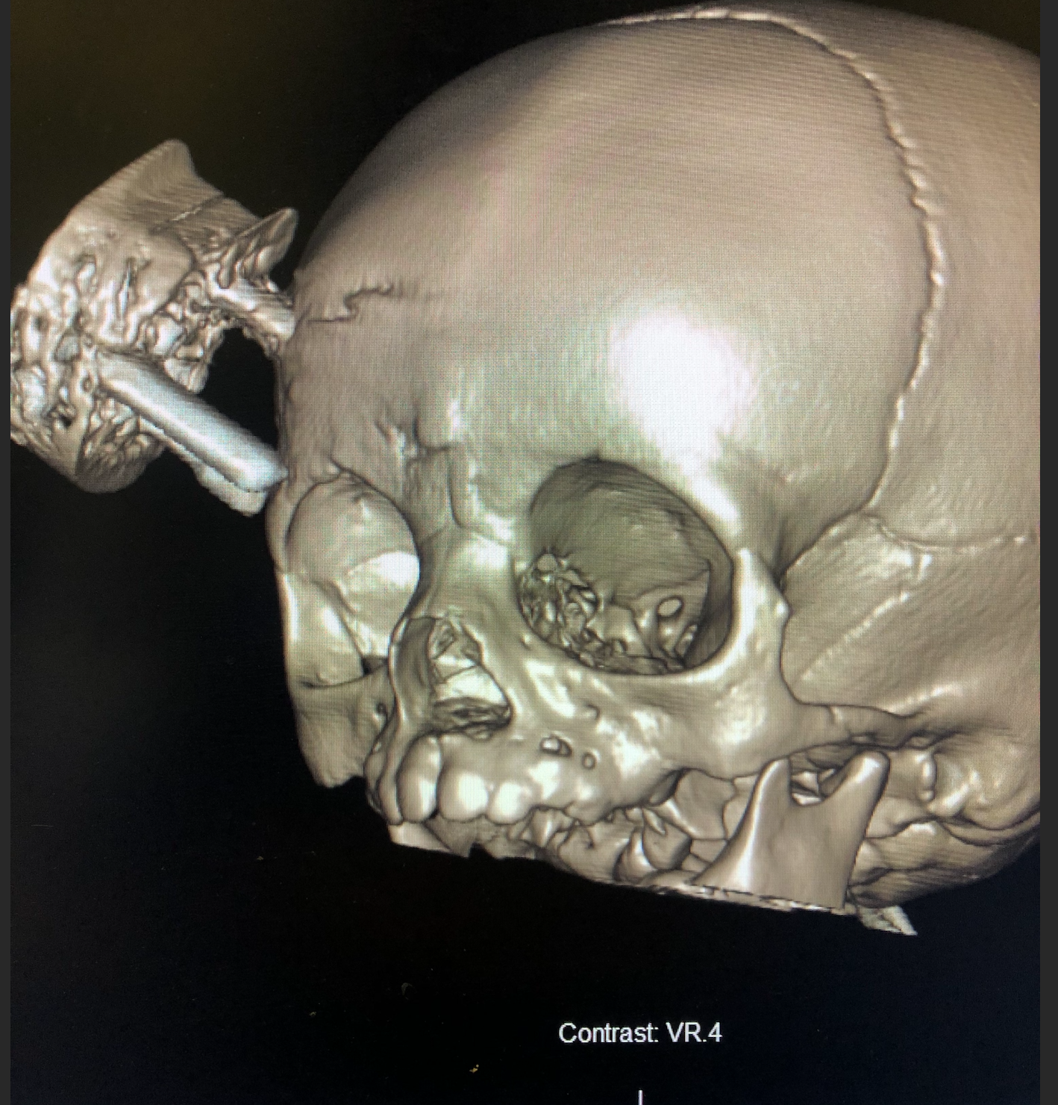
Challenges in determining cause from the medical evidence alone
Rare versus improbable
Childhood brain tumours
Annual incidence 40 per million
1 in 25,000
Notes:
Often rare is conflated with likelihood
Brain tumours
This is a rare disease
40 per million per year
4 per 100 000
0.4 per 10 000
1 in 25 000

Slide 37
Summary
Infants have large heads and weak necks – vulnerable to brain injury.
Skull fractures common after accidental falls at home.
Multifocal SDH surrogate marker of diffuse brain injury.
Encephalopathy reflects multitude of mechanisms occurring at the microscopic level.
Degree of hypoxic-ischaemic injury important determinant of outcome
Notes:
Taught that 80% of understanding what’s wrong with a patient is from the history

Slide 38
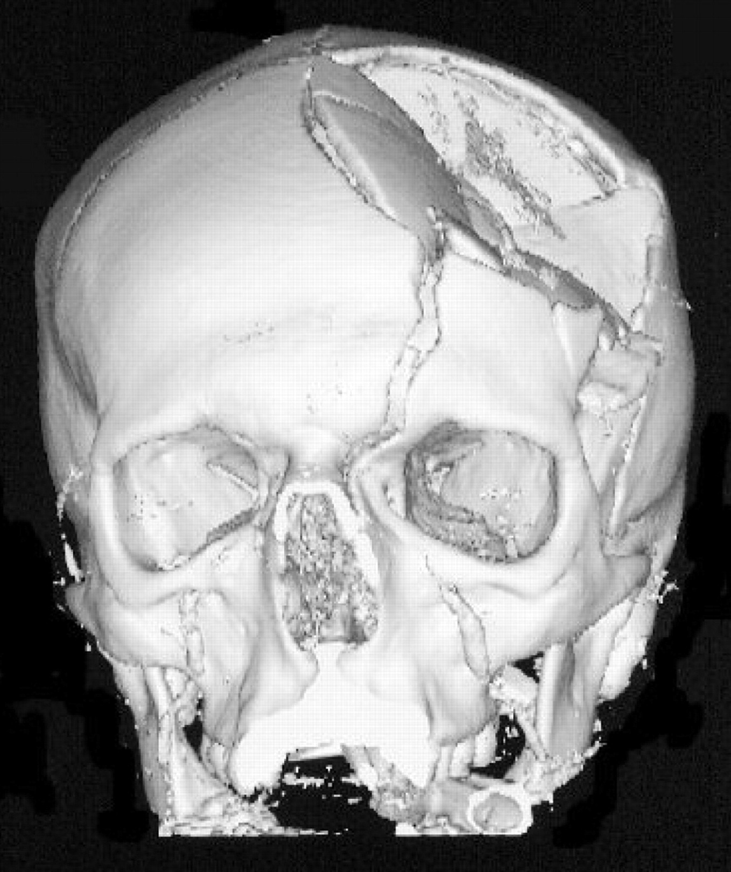
Summary
Limits of medical evidence. Never say never.
Medically unknown remains in the differential.
Notes:
Taught that 80% of understanding what’s wrong with a patient is from the history

