Slide 1
0 - 25 Disability Service
Transitions Team (14-25)

Slide 2
0-25 Service is made up of two teams:
0-16 : Disabled Children’s Service (Complex needs which in order to achieve outcomes appropriate to their potential, as a result of their disability, the child requires total or substantial support, not appropriate to their age, from another person which is not available within their family or wider network).
This means the team work within children’s legislation and adult legislation, two different databases and within two departments.
16 – 25 : Transition Team
Young people 16 and 17 are assessed under the Children Act 1989, so children who have a disability can be children in need if they are disabled or unlikely to achieve a reasonable standard of health or development unless services are provided .
We refer to lower level support as assessed with regards to the Chronically Sick and Disabled Persons Act 1970.

Slide 3
Key Objectives
Children and young people with a disability are supported on a smooth and clear pathway to adulthood which provides stability and is aspirational.
Flexible Person Centred Services and Support are integral within the team's practice offering young people & their families more choice and control.
Young people will be supported into appropriate housing with care options, employment, education and daytime occupation options.
Young people and families who do not meet eligibility criteria receive effective support via signposting.
Assessment, planning and intervention are integrated to provide a continuous, consistent and appropriate service for young people with a disability. Families will also experience a smoother pathway reducing stress levels, bureaucracy and the number of professionals involved.

Slide 4
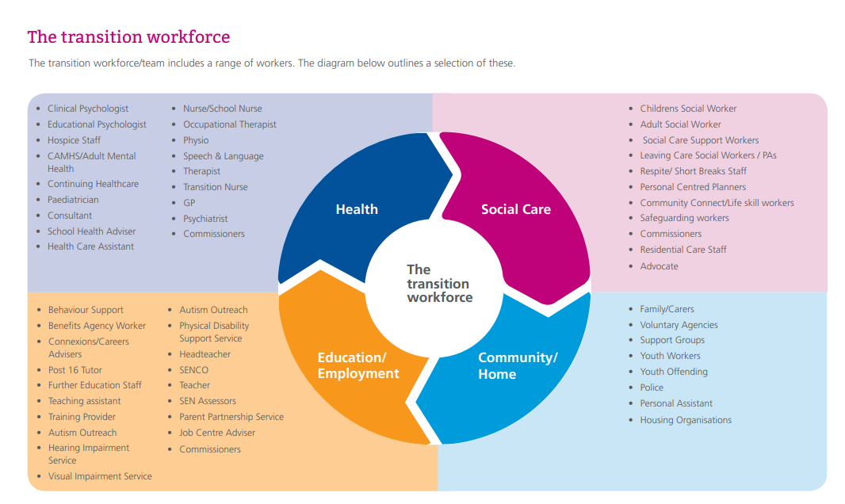

Slide 5
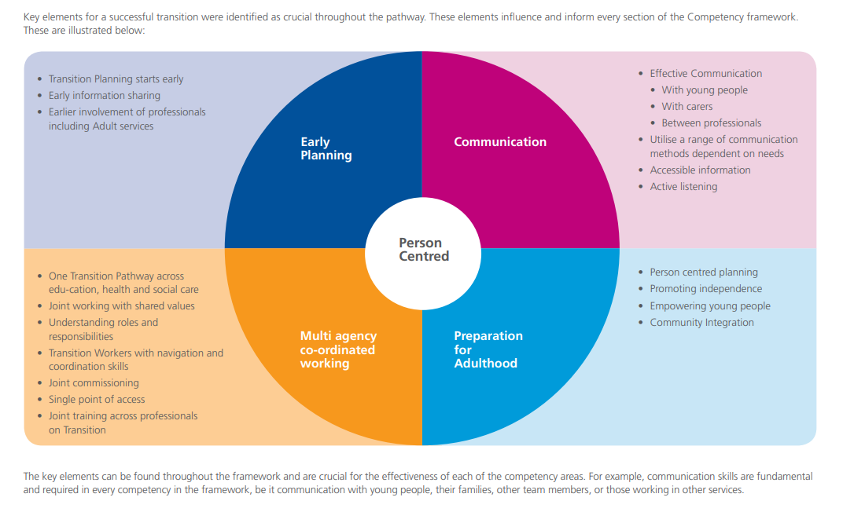

Slide 6
Key Challenges
Staffing and Retention
Staff working to different legislation
Accommodation and support services
MCA & DOLS; the conflict of DOLS and safeguarding for under 18s
Funding changes at 18
Managing expectations; streamlining of services at 18
Preparation for Adulthood (PFA)

Slide 7
Key Challenges
Outline of key challenges within the 0-25 Service and potential strategies to address these.
Staffing & Retention Challenges.
Staffing & Retention Strategy.
High vacancy rates in sector.
Perception of being a specialist (niche) role, despite being grass roots social work.
Inability to recruit and retain high quality social workers.
Supporting and retaining NQSWs.
Developing and upskilling staff – clear career progression.
Targeted recruitment campaign highlighting transferrable skills and learning and development opportunities.
Creating conditions that allow good Social Work to flourish.
Providing an environment where Social Workers are able to develop their practice and career.
Provide frequent student SW opportunities to ‘grow your own’; resulting in higher retention whilst upskilling existing/experienced staff in supporting and mentoring the future workforce.
Notes:
Workforce strategy groups are already firmly gripping the recruitment campaign for Peterborough social care across all services. However it is my view that this is dependent on each team managers engagement in focus groups and advertisement planning. The team managers attitude and approach to, not only what it is like to work within the team, but also their involvement in the recruitment campaign itself will undoubtedly have a positive impact. Such behaviour lends itself to developing innovative recruitment based upon the first-hand experience of the strengths and challenges of working within the service.
Aim to lower caseloads to under 20 to stop reactive social work rather than proactive social work. It is well known that long term reactive social work results in drift and delay in cases which makes it almost impossible to achieve good outcomes for children and young people.
Offer a high-quality environment and flexibility of working with a secure base at the heart of it. It’s the smaller things like ensuring that all staff have their own desk space, computer and phone that can make a real difference to motivation and performance. Things like access to your manager, available meeting rooms and a space for confidential discussions as and when the need arises, instead of spending valuable time searching high and low for a space to work and a space to talk. Having the flexibility and autonomy of agile working whilst also knowing where your peers are and that you have a safe a familiar space alongside your ‘work family’ when it matters most. In my experience it is often these small things that are extremely important as to how effectively a social worker can operate on a day to day basis.
The planning, implementation and regular review of a robust career pathway for NQSWs (and even students on placement) ensures that staff feel supported and developed every step of the way. With more experienced staff leading on this it is a dual pronged approach to investment into the development of social workers at all levels; whilst embedding a culture of both personal and professional growth and support.
Retention of staff will ensure stability within the service and a provision of experienced social workers who are able to undertake strong, relational social work alongside children and families rather than doing things to or for them. Equally stability within the workforce will allow us to build positive working relationships with partners and together deliver better outcomes for children and young people. That said this is not quick win stuff and there are no ‘magic bullets’ or off the peg solutions that will deliver you good recruitment or retention in three to six months.
Its of minimal cost to ensure that these fundamentals are in place. It is my view that the leadership team needs to consistently demonstrate the value they place on social work and social workers; because, if we do not treat them with respect and understanding; then how can we expect social workers to respect, understand and value the families they work with everyday.
It is this simple maxim that, in my opinion, should be at the heart of every social work retention strategy.

Slide 8
Transition Planning
Operational challenges
Working to differing legislation which can sometimes be conflicting; i.e balancing Children’s legislation and safeguarding decisions with DOLs.
Staff working across three recording systems; liquid logic, Early Help and Frameworki.
Managing expectations alongside streamline services in preparation for transition to adult services, eligibility and support at eighteen. Including changes in funding.
Adequately preparing young people and their families for the transition into adult services.
Notes:
Challenges around differing legislation and systems can be managed by ensuring adequate training to broaden team knowledge and confidence, particularly in less common areas. The impact and analysis of this can be followed up through monitoring performance data in respect of output of assessments and recordings as well as through quality assurance.
The need to broaden knowledge and confidence also applies to my own development in order to competently lead the team to ensure that services are run in compliance with the principles of all relevant legislation(s) embedded and integrated at every level. Particularly in respect of MCA and DOLS whereby there is a need for the strategic lead to be able to:
• Differentiate between MCA issues, safeguarding issues and issues that arise as a result of poor
commissioning.
• Be able to scrutinise documentation from colleagues and be able to have an auditing role.
• Be able to offer clear, expert advice and have a nuanced understanding of the differences between
safeguarding and MCA.
• Authorise Deprivation of Liberty safeguards.
• Represent their agencies within the Court of Protection.
• Ensure that there is appropriate support for social workers; including specialist legal advice.
Overall competently lead and informed social workers will deliver confident and competent services, despite system challenges or conflicts in legislation.
One of the biggest challenges will be to provide a service that adequately prepares individual YP and their families for the transition to adult services. Part of the role of children’s services or transition teams when caring for young people with complex health needs, is to prepare them for the differences they are likely to face at transfer to adult services.
Planning must start early, and funding responsibilities should be clear. Adult and children’s services should work together and information must be shared routinely so that young people and their parents don’t waste precious time repeating information about their health. Young people must not fall in the gap between children’s and adult services.
With this in mind I have identified three key areas to improve the experience of transition for young people and their families.
1. Commissioners must listen to and learn from young people and their families. - The Children and Families Act and Care Act are an opportunity to get transition right for young people by sharing accurate data, planning ahead and implementing existing best practice guidance for transition. Young people and their families are the experts in their own lives. They know what works and they know what goes wrong. Clinical commissioning groups and local authorities must listen and learn from those experiences.
2. Existing good practice guidance must be followed to ensure young people are properly supported through
transition. – In my view there is little need to re-invent the wheel. With the existing guidance routinely
implemented we would jointly be able to significantly improve the quality of care during transition for all of our young people and their families. Every young person with complex physical health needs, from age 14 should have: • A key accountable individual responsible for supporting their move to adult services. • A documented transition plan that includes their health needs. • A communication or ‘health passport’ to
ensure relevant professionals have access to essential information about the young person. • Training and advice to prepare them and their parents for the transition to adult care, including consent and advocacy. • Respite and short break facilities available to meet their assessed needs and those of their families.
3. Adolescence/young adulthood should be recognised across all agencies as an important developmental phase - Services should be tailored to meet the needs of this group and include additional recognised training for staff from all sectors, working together to plan and deliver all necessary services. What matters most is that services must be integrated, and care coordinated around the individual, with an optimal experience of transition to adult services for those young people who require ongoing health and care in adult life – whatever their age.
From the age of 14, young people with complex health needs, and their families, should be helped to prepare for the differences they will encounter as they become adults. Best practice would see that each young person has consistent staff­ members who know about the young person’s conditions and history. Good communication with young people, their parents and each other. Providing good information about what to expect; including agreement of responsibility for funding (as early in the process as possible). So to alleviate anxieties and provide information and understanding regarding joint commissioning arrangements under the continuing [health] care framework.

Slide 9
Transition Planning
Strategic challenges
Preparation for adulthood; pathway for young people that enables independence and lessens dependence with positive outcomes in respect of health, education, employment, independent living, communities and young people and families.
Lack of suitable accommodation and support services which also represent value for money in an equitable way.
Education, employment or training opportunities that are inclusive; developing skills and opportunities within society for disabled young people.
Adequately preparing young people and their families for the transition into adult services.
Notes:
Through the Preparation for adulthood pathwaywe will be able to evidence positive outcomes for young people with SEND.
This can be achieved by an up to date local offer that will provide children, young people and their families with up to date, clear information, on what is available locally through the local offer. The revised local offer will also encompass a feedback and review mechanism for commissioners to capture information on where there are gaps for families. This will also enable young people and their families to be involved in strategic planning and service design and will support commissioners in the design and development of future services.
The preparation for adulthood programme will assist us to develop an integrated shared vision with CCGs and their partners to deliver joint commissioning duties as contained within the Children and Families Act, with particular reference to the interface between children and adults services and the care act. Through this pathway we can work towards jointly planning and commissioning services to improve post 16 options and support within the key identified areas of health, education, employment, independent living, communities and young people and families. As part of the Adults Positive Challenge Programme there is a work stream of ‘Preparing For Adulthood’. This links through to the SEND Programme Board and is focussed on the young person, ensuring their strengths, interests and outcomes are at the centre of support planning processes whilst ensuring value for money and/or reduction in expenditure.
SEND QCA inspection
https://www.peterborough.gov.uk/asset-library/peterboroughcitycouncillocalaccount2018-19.pdf

Slide 10
Thank you for listening Click here to watch video
01733 864397
ma Kavngh
Pcctransitionsteam@peterborough.gov.uk

